Slide 1
Causal-Consistent Reversible Debugging
Ivan Lanese
Focus research group
Computer Science and Engineering Department
University of Bologna/INRIA
Bologna, Italy
Joint work with Elena Giachino (FOCUS) and Claudio Antares Mezzina (FBK Trento)

Slide 2
Reversibility for debugging
Our claim: Causal-consistent reversibility can help the programmer to debug concurrent applications
Reversibility helpful also in a sequential setting
Some commercial debuggers provide the command “step back” in a sequential setting
For instance, gdb
Can we apply similar techniques in a concurrent setting?
Can we do better?

Slide 3
Debugging and causality
Debugging amounts to find the bug that caused a given misbehavior
Debugging strategy: follow causality links backward from misbehavior to bug
Which primitives do we need?
Mainly, primitives that given a misbehavior go back towards its causes
We define them in the context of μOz

Slide 4
μOz
A kernel language of Oz [P. Van Roy and S. Haridi. Concepts, Techniques and Models of Computer Programming. MIT Press, 2004]
Oz is at the base of the Mozart language
Thread-based concurrency
Asynchronous communication via ports
Shared memory
Variable names are sent, not their content
Variables are always created fresh and never modified
Higher-order language
Procedures can be communicated

Slide 5
Main primitives
One primitive for each possible misbehavior
Wrong value in a variable: rollvariable id goes to the state just before the creation of variable id
Wrong value in a queue element: rollsend id n undoes the last n sends to port id
If n is unspecied, the last send is undone
Thread blocked on a receive: rollreceive id n undoes the last n reads on the port id
If n is unspecied, the last receive is undone
Unexpected thread: rollthread t undoes the creation of thread t

Slide 6
Using causal-consistent primitives
The programmer can follow causality links backward
No need for the programmer to know which thread or instruction originated the misbehavior
The primitives find them
The procedure can be iterated till the bug is found
Only relevant actions are undone
All the primitives in the last slide are causal consistent

Slide 7
Additional commands
A debugger needs two kinds of commands
Commands to control execution
Commands to explore the configuration
Both code and state
Some of the commands are standard, others related to reversibility or causal consistency

Slide 8
Execution control commands: standard
Step forward
The user specifies the target thread
Run
Round robin scheduler
Breakpoints

Slide 9
Execution control commands: non standard
Step backward
Goes back one step
The user specifies the target thread
Not enabled if waiting for dependencies to be undone
E.g, cannot step back the creation of a thread with not empty history
Only in reversible debuggers
Roll t n
Undoes the last n actions of thread t
Causal consistent
Only in causal-consistent reversible debuggers

Slide 10
Configuration exploration commands
List of threads
Only in concurrent debuggers
Display the code of a thread
Display the history of a thread
Only in reversible debuggers
Display the store
Display the history of a queue
Only in reversible debuggers

Slide 11
Testing our approach
According to [Lu et al., ASPLOS 08] most of the concurrency bugs
Involve only 2 threads, and a few variables
Are order violation, atomicity violation or deadlock
The causal-consitent approach allows the programmer to concentrate on the involved threads
We put our debugger at work on three paradigmatic examples, one for each class of common bugs

Slide 12
CaReDeb: a causal-consistent debugger
Only a prototype to test our ideas
Debugs μOz programs
Written in Java
Based on the reversible semantics of μOz
Available at http://proton.inrialpes.fr/~mezzina/deb/
Starts with java –jar deb.jar inputfile

Slide 13
CaReDeb: a causal-consistent debugger
DEMO

Slide 14
Future work
Improving the prototype
Usability: integration with eclipse
Performance: both in time and in space
Extending the language
Additional constructs
What about applying the approach to a mainstream language?
Assessment
Can we improve the rate of bug discovery thanks to our approach?

Slide 15
Finally
Thanks!
Questions?

Slide 16
µOz syntax
S ::= [Statements]
skip [Empty statement]
S₁ S₂ [Sequence]
let x = v in S end [Variable declaration]
if x then S₁ else S₂ end [Conditional]
thread S end [Thread creation]
let x=c in S end [Procedure declaration]
{x x₁ … x_{n}} [Procedure call]
let x=Newport in S end [Port creation]
{Send x y} [Send]
let x ={Receive y} in S end [Receive]
c ::= proc {x₁ … x_{n}} S end

Slide 17
μOz semantics
Semantics defined by a stack-based abstract machine
The abstract machine exploits a run-time syntax
Each thread is a stack of instructions
The starting program is inserted into a stack
Thread creation creates new stacks
Procedures are stored as closures
Ports are queues of variables
Semantics closed under
Contexts (for both code and state)
Structural congruence

Slide 18
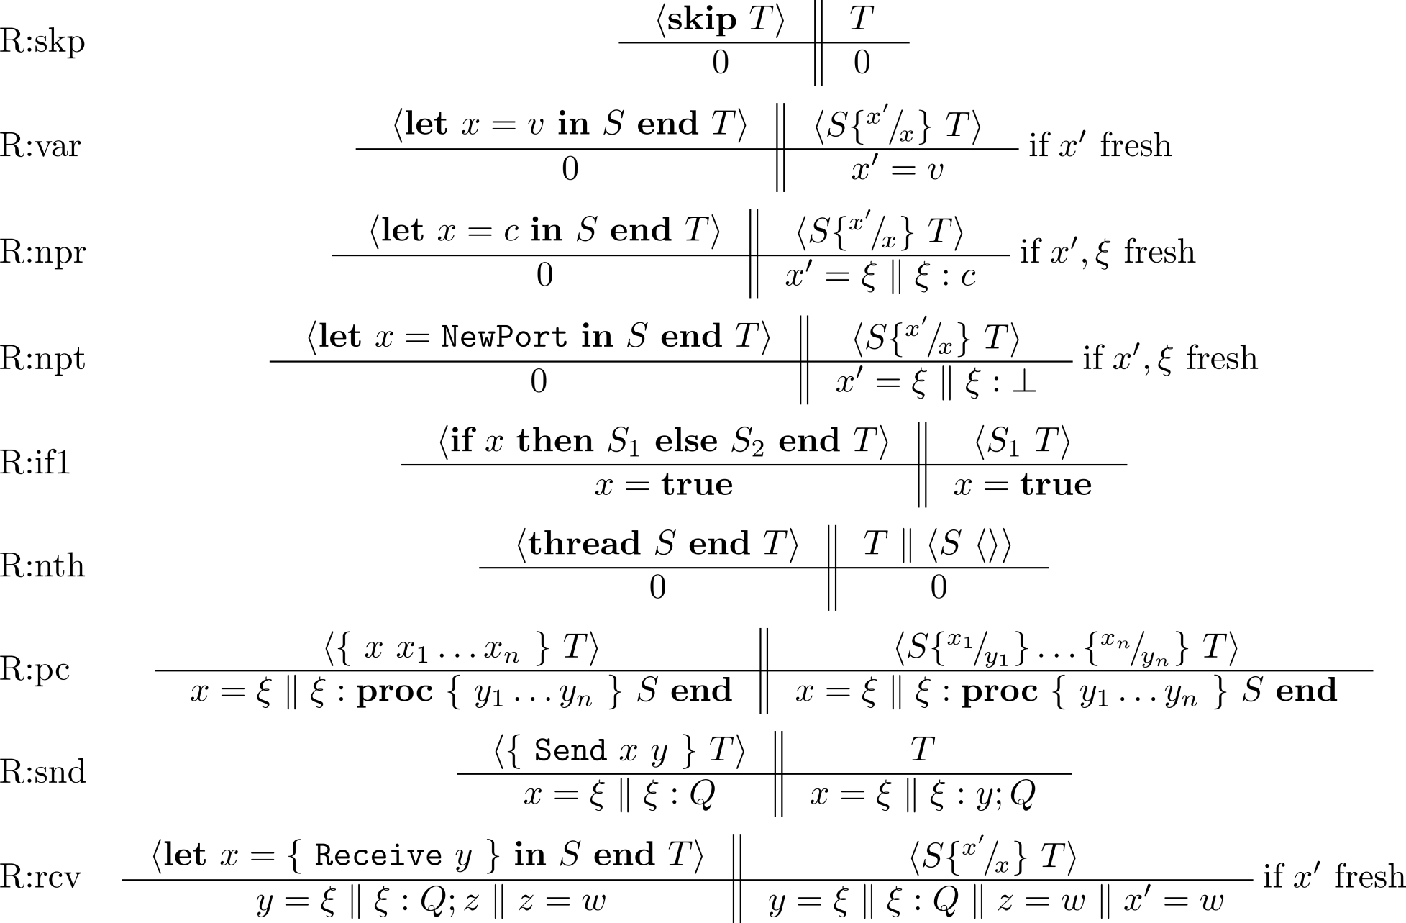
μOz semantics: rules

Slide 19
μOz reversible semantics
We give unique names to threads
We add histories to threads to remember past actions
We add a delimiter to record when scopes end
For let
For procedure body
For if-then-else
Ports have histories too
Should record also sender and receiver of each message
We do not want to change the order of communications

Slide 20
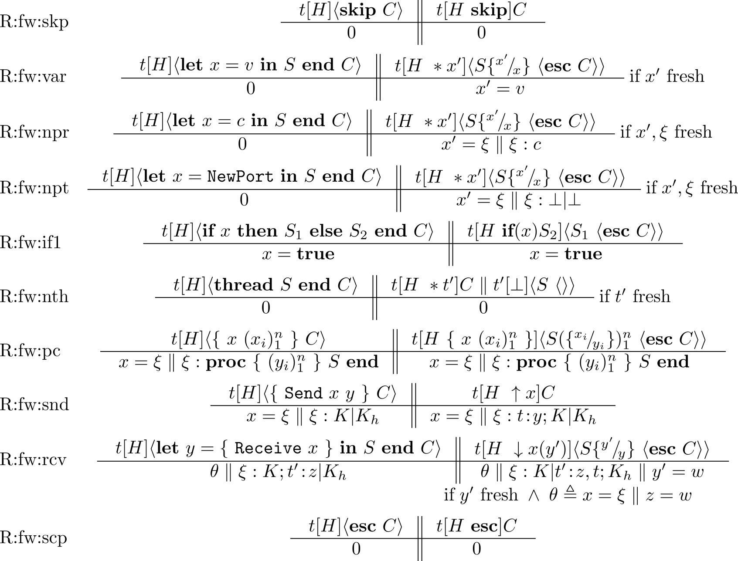
μOz reversible semantics: forward rules

Slide 21
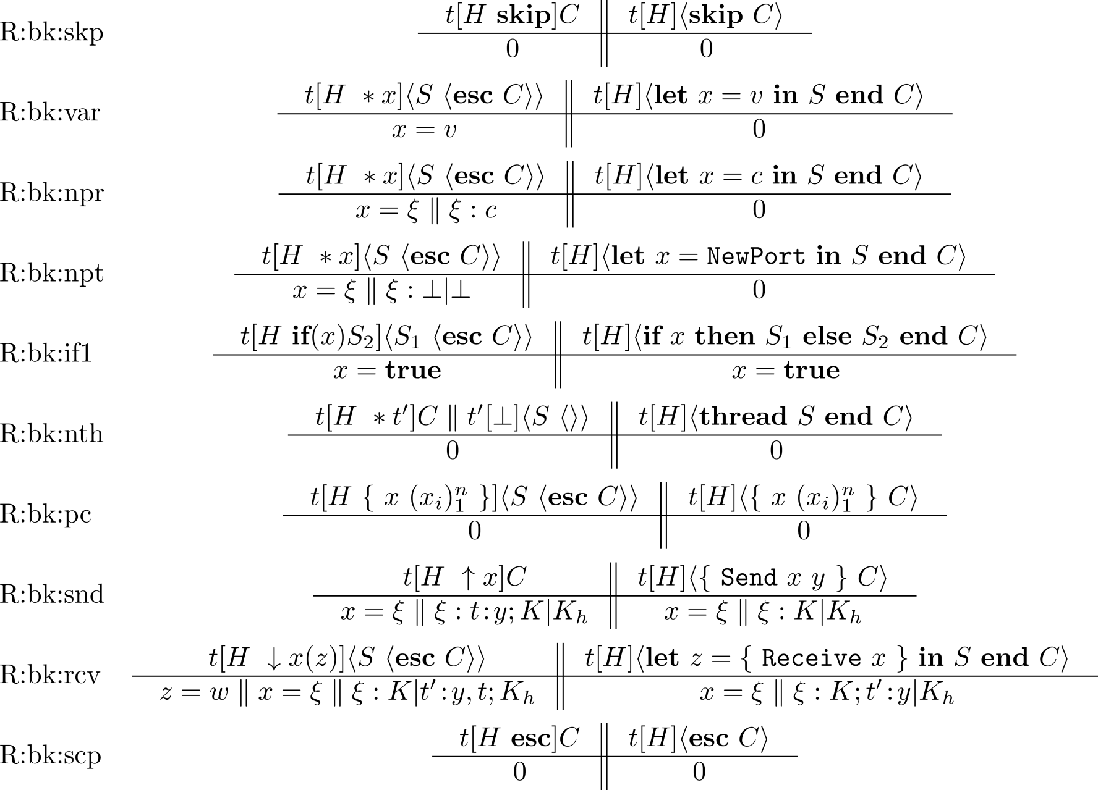
μOz reversible semantics: backward rules

