Slide 1
Causal-Consistent Reversibility in a Tuple-Based Language
Ivan Lanese
Computer Science Department
University of Bologna/INRIA
Italy
Joint work with Elena Giachino, Claudio Antares Mezzina and Francesco Tiezzi

Slide 2
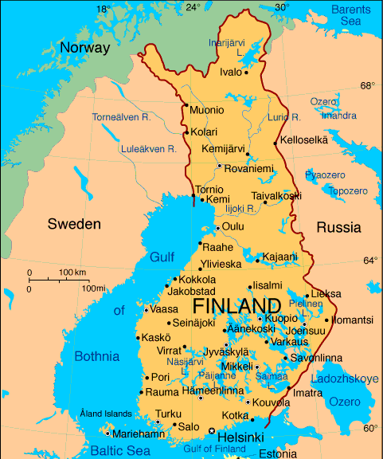
Map of the talk
Reversibility
Klaim
Uncontrolled reversibility in Klaim
Controlling reversibility: roll operator
Conclusions

Slide 3
What is reversibility?
The possibility of executing a computation both in the standard, forward direction, and in the backward direction, going back to a past state
Reversibility everywhere
chemistry/biology
quantum computing
state space exploration
debugging
…

Slide 4
Our aim
We want to exploit reversibility for programming reliable concurrent and distributed systems
To make a system reliable we want to escape “bad” states
If a bad state is reached, reversibility allows one to go back to some past “good” state
We think that reversibility is the key to
Understand existing patterns for programming reliable systems, e.g. checkpointing, rollback-recovery, transactions, …
Combine and improve them
Develop new patterns

Slide 5
Reverse execution of a sequential program
Recursively undo the last action
Computations are undone in reverse order
To reverse A;B first reverse B, then reverse A
We want the Loop Lemma to hold
From state S, doing A and then undoing A should lead back to S
From state S, undoing A (if A is in the past) and then redoing A should lead back to S

Slide 6
Avoiding loss of information
Undoing computational actions may not be easy
Computational actions may cause loss of information
X = 5 causes the loss of the past value of X
Restrict to languages that never lose information
X = X + 1 does not lose information
Take languages that would lose information, and save this information
X = 5 becomes reversible by recording the old value of X

Slide 7
Reversibility and concurrency
The sequential definition, recursively undo the last action, is no more applicable
Which is the last action in a concurrent setting?
Executions of many actions may overlap
For sure, if an action A caused an action B, A could not be the last one
Causal-consistent reversibility: recursively undo any action whose consequences (if any) have already been undone

Slide 8
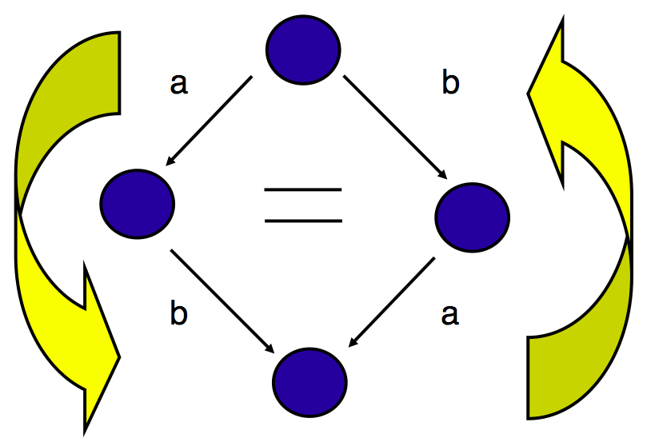
Causal-consistent reversibility

Slide 9
Reversibility and concurrency
Two sequential actions should be undone in reverse order
Two concurrent actions can be undone in any order
Choosing an interleaving for them is an arbitrary choice
It should have no impact on the possible reverse behaviors

Slide 10
Map of the talk
Reversibility
Klaim
Uncontrolled reversibility in Klaim
Controlling reversibility: roll operator
Conclusions

Slide 11
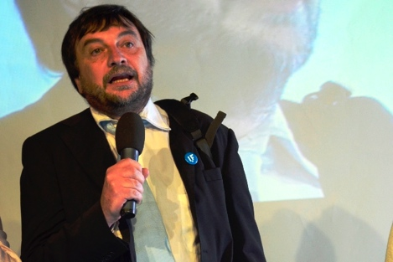
Klaim
Coordination language based on distributed tuple spaces
Linda operations for creating and accessing tuples
Tuples accessed via pattern-matching
Klaim nets composed by distributed nodes containing processes and data (tuples)
We consider a subset of Klaim called μKlaim

Slide 12
μKlaim syntax

Slide 13
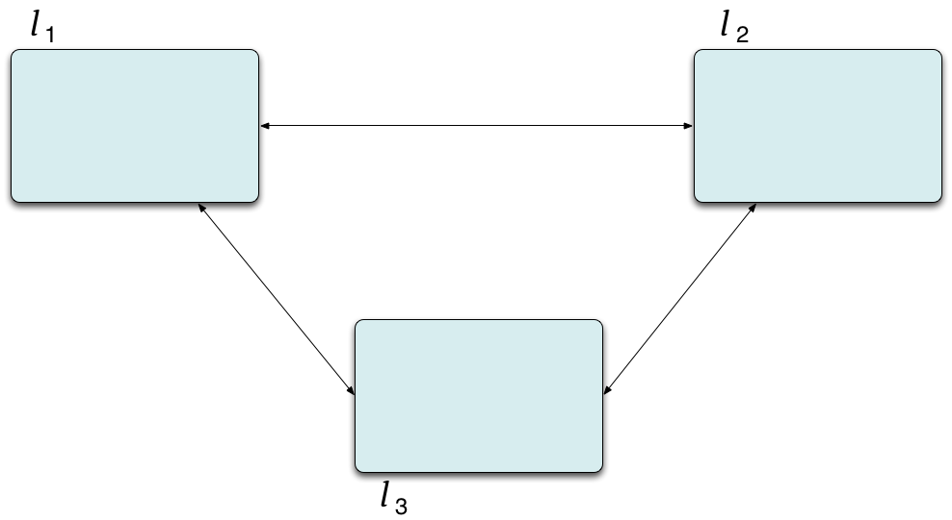
μKlaim syntax

Slide 14
μKlaim syntax

Slide 15
μKlaim syntax

Slide 16
μKlaim syntax

Slide 17
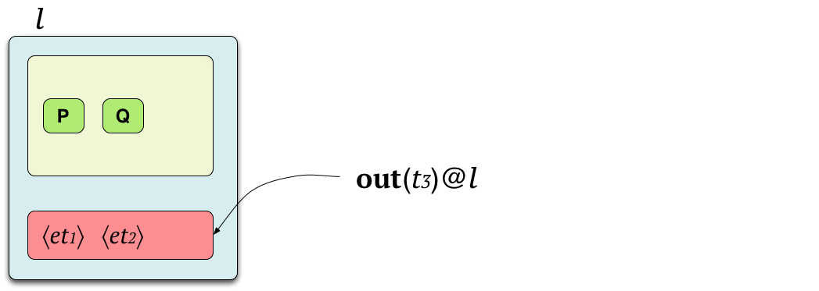
μKlaim syntax

Slide 18
μKlaim syntax

Slide 19
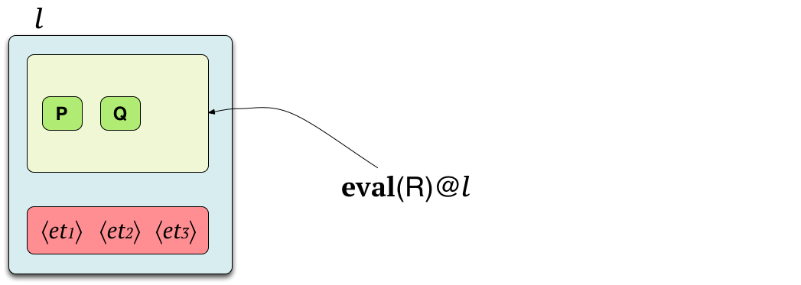
μKlaim syntax

Slide 20
μKlaim syntax

Slide 21
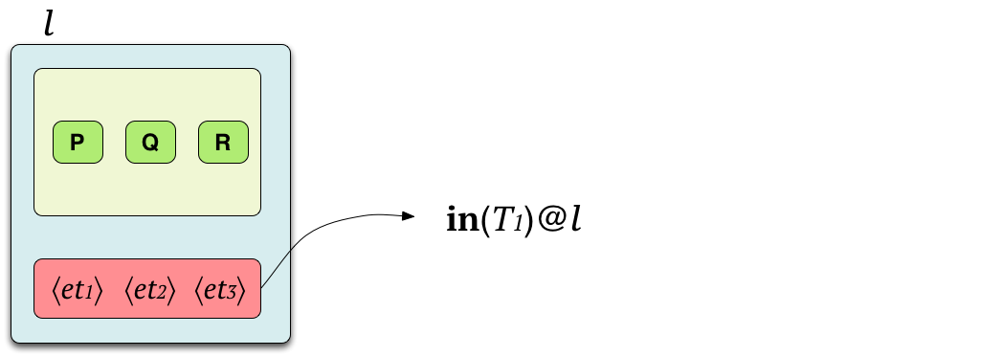
μKlaim syntax

Slide 22
μKlaim syntax

Slide 23
μKlaim syntax

Slide 24
μKlaim syntax

Slide 25
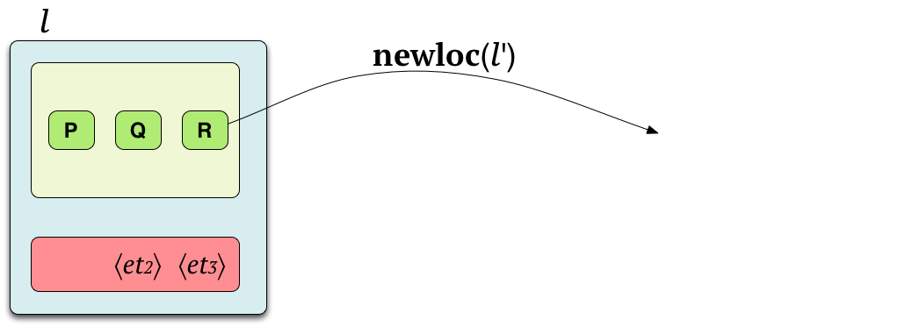
μKlaim syntax

Slide 26
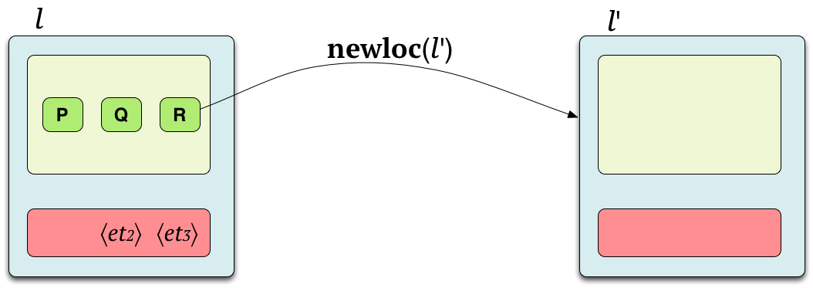
μKlaim syntax

Slide 27
Example

Slide 28
Map of the talk
Reversibility
Klaim
Uncontrolled reversibility in Klaim
Controlling reversibility: roll operator
Conclusions

Slide 29
Making μKlaim reversible
We define RμKlaim, an extension of μKlaim allowing: - forward actions, corresponding to μKlaim actions - backward actions, undoing them
One has to trace history and causality information
We label evaluated tuples and processes with unique keys $k$
We use connectors $k_{1}≺(k_{2},k_{3})$ to store causality information
We use memories to store past actions
Similarly to past works on other languages

Slide 30
Making μKlaim reversible
We have to deal with some peculiarities of μKlaim causality structure
Read dependencies
Two reads on the same tuple should not create dependences
If the out creating the tuple is undone then reads on the same tuple should be undone too
Localities
Localities are resources and establish dependences
To undo a newloc one has to undo all the operations on the created locality

Slide 31
RμKlaim syntax

Slide 32
Example

Slide 33
Example
execute in in l₂
execute out in l₂
execute in in l₃
execute out in l₃

Slide 34
Example
execute in in l₂
execute out in l₂
execute in in l₃
it needs to perform
a backward step
execute out in l₃

Slide 35
Properties
The forward semantics of RμKlaim is an annotated version of the semantics of μKlaim
The Loop Lemma holds
i.e., each reduction in RμKlaim has an inverse
RμKlaim is causally consistent

Slide 36
Concurrency in RμKlaim
Two transitions are concurrent unless
They use the same resource
At least one transition does not use it in read-only modality
Resources defined by function λ on memories
Read uses the tuple in read-only modality
All primitives but newloc use the target locality in read-only modality

Slide 37
Causal consistency
Causal equivalence identifies traces that differ only for
swaps of concurrent transitions
simplifications of inverse transitions
Casual consistency: there is a unique way to go from one state to another up to causal equivalence
causal equivalent traces can be reversed in the same ways
traces which are not causal equivalent lead to distinct nets

Slide 38
Is uncontrolled reversibility enough?
Uncontrolled reversibility is a suitable setting to understand and prove properties about reversibility
... but it is not suitable for programming (reliable) systems
Actions are done and undone nondeterministically
A program may diverge by doing and undoing the same action forever
No way to keep good results

Slide 39
Map of the talk
Reversibility
Klaim
Uncontrolled reversibility in Klaim
Controlling reversibility: roll operator
Conclusions

Slide 40
Controlling reversibility
In reliable systems
Normal execution is forward
Backward execution is used to escape bad states
We add to μKlaim a roll operator
To undo a given past action
Together with all its consequences (and only them)
We call CRμKlaim the extension of μKlaim with roll

Slide 41
CRμKlaim syntax

Slide 42
Example
From
We get
When we undo the out we need to restore the in
The formal semantics is quite tricky

Slide 43
Results
CRμKlaim is a controlled version of RμKlaim
It inherits its properties

Slide 44
Map of the talk
Reversibility
Klaim
Uncontrolled reversibility in Klaim
Controlling reversibility: roll operator
Conclusions

Slide 45
Summary
We defined uncontrolled and controlled causal-consistent reversibility for μKlaim
Two peculiar features taken into account
Read dependences
Allow to avoid spurious dependencies
Localities

Slide 46
Future work
Defining a low-level controlled semantics closer to an actual implementation
Study the relationships with patterns for reliability
Using the controlled semantics to define a reversible debugger for μKlaim
Extend the approach to mainstream languages
Interesting preliminary results for actor based languages

Slide 47
Thanks!
Questions?

Slide 48
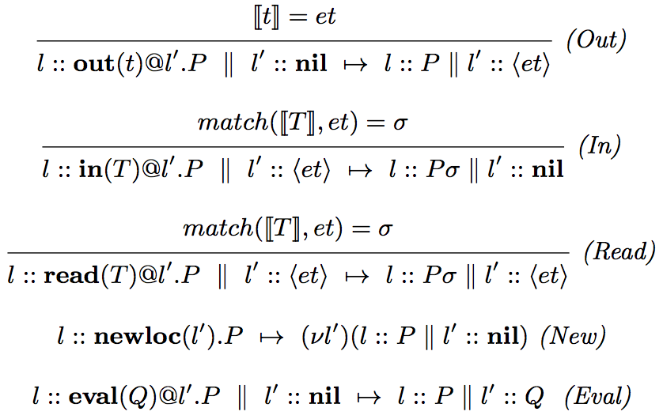
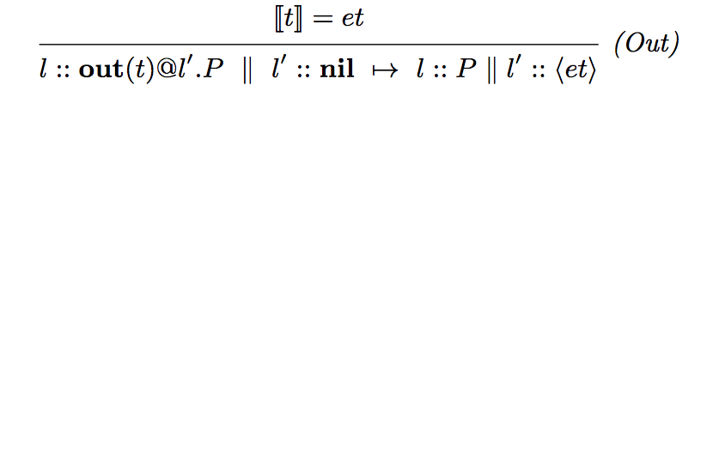
μKlaim semantics

Slide 49
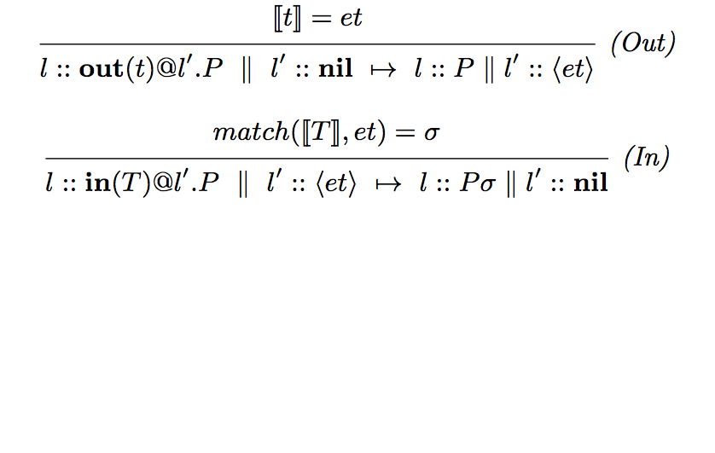
μKlaim semantics

Slide 50
μKlaim semantics

Slide 51
μKlaim semantics
Evaluation-closed relation
A relation is evaluation closed if it is closed under active contexts
N1 ⟼ N1′ implies N1 || N2 ⟼ N1′ || N2 and (νl) N1 ⟼ (νl)N1′
and under structural congruence
N≡M ⟼ M′ ≡N′ implies N ⟼ N′
μKlaim semantics
The μKlaim reduction relation ⟼ is the smallest evaluation-closed relation satisfying the rules in previous slide

Slide 52
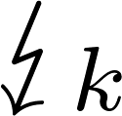
CRμKlaim semantics
M is complete and depends on k
N_{t}: if the undone action is an in, we should release the tuple
N_{l}: we should not consume the roll locality, unless created by the undone computation
N : resources consumed by the computation should be released

