Slide 1
Towards Global and Local Types for Adaptation
Ivan Lanese
Computer Science Department
University of Bologna/INRIA
Italy
Joint work with Mario Bravetti, Marco Carbone, Thomas Hildebrandt, Jacopo Mauro, Jorge A. Perez and Gianluigi Zavattaro

Slide 2
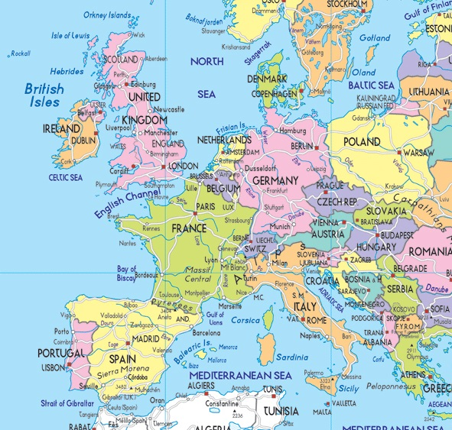
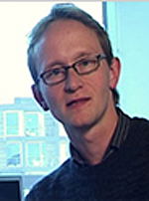
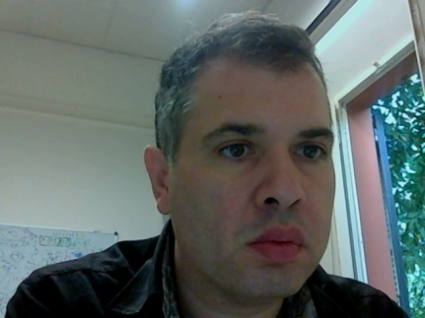
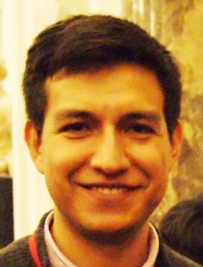
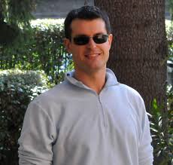
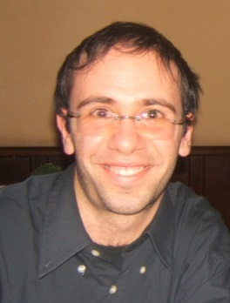
Many distributed participants

Slide 3
Complex multiparty interactions
Jacopo and Ivan were working on adaptive choreographies (with others)
Marco was working on multiparty session types (with others)
Mario, Jorge and Gianluigi were working on adaptable calculi (with others)
Thomas was working on adaptable case management systems (with others)
Mario, Marco, Thomas, Ivan, Jacopo, Jorge and Gianluigi wanted to start a collaboration on multiparty session types and adaptation

Slide 4
Message-based communication (e-mail)
CaseStudy: Thomas → Mario Thomas sends a proposal for a case study to Mario
CommentsReq: Mario → Ivan Mario asks Ivan for comments on the syntax
WriteConcl: Gianluigi → Jorge Gianluigi asks Jorge to write conclusions
Cut: Mario → Jacopo Mario asks Jacopo to cut the paper to respect the page limit

Slide 5
Participants act according to the choreography
CommentsReq: Mario → Ivan; Comments: Ivan → Mario
Ivan behavior should follow the type: CommentsReq_{Mario};Comments_{Mario}
Ivan code interleaves different sessions: k : CommentsReq_{Mario}(x); k’ : BuyBread_{Wife}; k’ : Bread_{Wife}<1kg>; k : Comments_{Mario}<comm.txt>
Each session respects a given type

Slide 6
Unexpected adaptation needs
External adaptation need:
Simon Gay announces BEAT II: the choreography is adapted to submit a work-in-progress to it
Marco notices that most of us will attend DisCoTec 2013: the choreography is adapted to exploit this occasion to work together
Marco is a participant of the choreography, but
DisCoTec attendance is not mentioned in the choreography
It may be part of another choreography Marco is participating to
Internal adaptation need:
Mario finds a bug in the definition of traces: the choreography is adapted by adding interactions to fix it

Slide 7
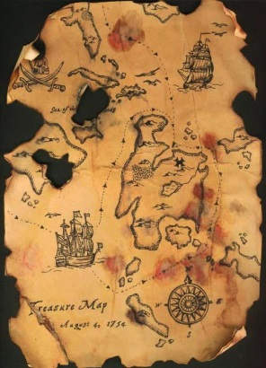
Our plan
Write choreographies to describe complex multiparty interactions
Derive a description of the behavior of each participant
Type the code of each participant according to its local description(s)
The code may involve many interleaved sessions
Typing ensures good properties
The code follows the expected protocol(s)
No deadlock

Slide 8
Our plan
Write choreographies to describe complex multiparty interactions
Derive a description of the behavior of each participant
Type the code of each participant according to its local description(s)
The code may involve many interleaved sessions
Typing ensures good properties
The code follows the expected protocol
No deadlock
Adaptation

Slide 9
Adaptation
Systems should live for long periods of time
Systems should adapt to
Changes in the environment (new technologies, protocols, unexpected workload)
Changes in users minds (new requirements, changing business rules)
Adaptation happens at runtime
The system should be adapted with minimal disruption of functionalities
No shut down, recompile, and restart

Slide 10
How to face the unexpected?
Adaptation details (frequently) not known when the system has been designed or even started
To face those unexpected challenges something should come from outside
New code
Exploiting the new technology, defining the new business rule, ...
The system should provide an interface to
Interact with an adaptation middleware
Get new code
Combine it with the existing code

Slide 11
Internal vs external updates
External updates
New code from the environment
A participant of another choreography
The human user via some interface
Fundamental to deal with unexpected events
Internal updates
New code from a participant of the choreography
Towards another area of the same choreography
Useful as a programming construct, e.g., for error handling
Enhances compositionality
Specifying the choreographies and the updates in the same language useful for refinement

Slide 12
Adaptation and multiparty session types
Lots of works on adaptation exist
Our main contribution is not an innovative way of doing adaptation
Formal approaches emerging only very recently
Our main contribution is in guaranteeing desirable properties
Trade off between
Allowing substantial adaptations
One would be able to change everything
Preserving good properties
Easier if one changes very little
Easier if one knows in advance what is changing and how
Adaptive multiparty session types provide a good trade off

Slide 13
Adaptation constructs
Impossible to guarentee good properties if adaptations can happen everywhere
We need a construct to specify where adaptation can happen
We call it a scope
A scope contains code, to be executed if no adaptation occurs
Running scopes can be adapted too (also from inside)
A construct is needed for internal update
Should provide the new code for a given scope
Similar constructs at the level of choreographies, endpoints and code

Slide 14
Constructs for external update
None
External updates come from outside
Not specified in the choreography
The system does not know how things will change
We add external updates to the semantics, extending the notion of traces
External updates are updates coming from a parallel (unspecified) choreography

Slide 15
Choreography language
Composed by interactions of the form CommentsReq: Mario → Ivan
Standard composition operators: sequence ; parallel | choice + Kleene star *
Two operators for adaptation
X:T[C] scope with name X executing choreography C with set of roles (at most) T
X_{r}{C} internal update of a scope done by role r, inserting in the scope with name X the new choreography C

Slide 16
Endpoint language
Processes composed by inputs and outputs of the form CommentsReq_{Ivan} CommentsReq_{Mario}
The same composition operators as before: sequence ; parallel | choice + Kleene star *
Two operators for adaptation
X[P] scope with name X executing process P
X_{(r1,...,rn)}{P₁,...,P_{n}} update of a scope X sending process P_{i} to endpoint r_{i}
A single update involves multiple endpoints
A system description is a parallel composition of endpoints
Each endpoint has a name and executes a process

Slide 17
Projection
Allows one to automatically derive from a choreography the description of each endpoint
Distributing the behavior among participants
Op: r → s | r = Op_{s} Op: r → s | s = Op_{r} Op: r → s | r’ = 1
X:T[C] | r = X[C|r] if r in T X:T[C] | r = 1 otherwise
X_{s}{C} | r = X_{(r1,...,rn)}{C|r₁,...,C|r_{n}} if r=s, type(X)={r₁,...,r_{n}} X_{s}{C} | r = 1 otherwise
Other operators are projected homomorphically

Slide 18
Expected result
The traces of the projected system are included in the traces of the choreography
For all possible adaptations
Holds only for well formed choreographies and adaptations
Key challenge: ensuring that all the participants agree on where we are in the choreography
Which branch has been taken in a choice
Whether a given scope should be adapted or not
Which is the new code for a given scope
When one should stop executing the old code and start executing the new one
Semantics carefully crafted to ensure this

Slide 19
Adapting a scope, graphically
X
X→
X

Slide 20
Adapting a scope, graphically
X
X→
X
proj

Slide 21
Adapting a scope, graphically
X
X→
X
proj
proj
X→

Slide 22
Adapting a scope, graphically
X
X→
X
proj
proj
proj
X→

Slide 23
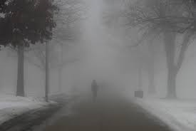
And now the foggy part

Slide 24
Typing a concrete language
We see endpoint processes as protocol types for programs written in a more concrete language
A program will execute different sessions in interleaving
Ivan program will execute the ‘Working on adaptive session types’ session, the ‘Take care of family’ session, ...
Each participant in each session follows a protocol
Obtained by projecting the corresponding choreography on the chosen participant
This ensures that the good properties of the protocols are reflected in the program
More troubles come from the interleaving of sessions

Slide 25
Adapting interleaved sessions
To adapt the code of a participant
All the protocols executed by the code should allow for the adaptation
They should all feature a scope with the given name
The adaptation may come from one of them or from outside
Adapting one participant requires to update the other participants too
May be involved in other protocols
More participants may need to be considered

Slide 26
Current state
This is a work in (very slow) progress
What we have
Syntax and semantics for choreographies and endpoints
Projection
A more serious example
What we have still to do
Correctness proof, concrete language, typing rules, correctness of typing

Slide 27
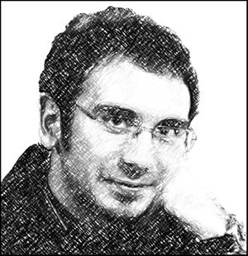
Introducing next talk
This work is very related to the work on adaptive choreographies presented in next talk
This work is at the level of types, the other one at the level of language
The other work only considers external updates
The other work is at a more advanced stage (currently submitted)

Slide 28
Future work
Complete the current work
Fully understand the interplay between interleaved sessions and adaptation
Refinement
This was our original motivation
Having internal updates motivated (also) by this

Slide 29
End of talk
Thanks!
Questions?

