Slide 1
Software development & Reversibility: open problems
Claudio Antares Mezzina
(with special suggestions from Lanese & Ulidowski & Tuosto)
IMT School for Advanced Studies Lucca
WG1 Meeting, Cyprus

Slide 2
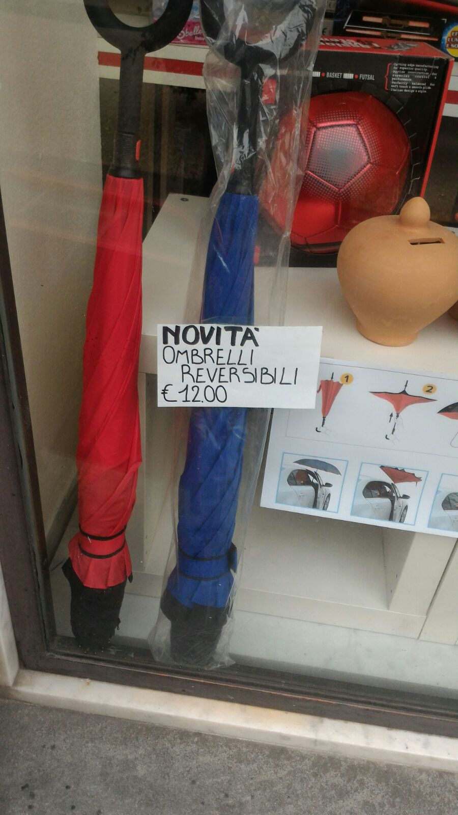

Slide 3
Software development
According to Software Engineering we can distinguish three main phases during software development
Specification
Implementation
Validation / Verification

Slide 4
Sequential VS Concurrent
In this talk we will just focus on Concurrent Programs
There exists two concurrency models
Shared Memory SM
Message Passing MP

Slide 5
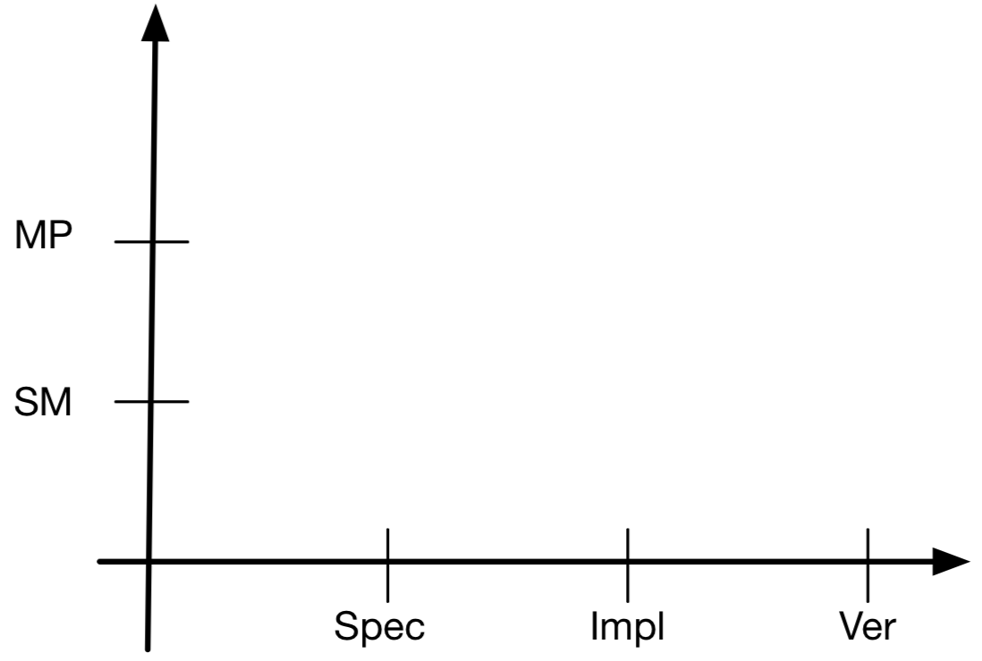
Problem Spectrum

Slide 6
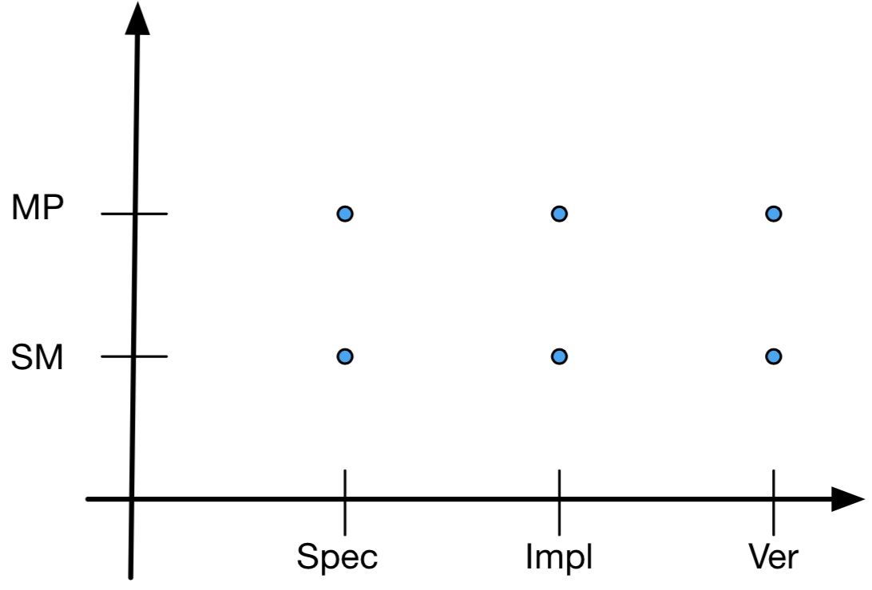
Problem Spectrum

Slide 7
Concurrent
Specification
There exist formalisms which are general enough to work with both (Spec, MP) and (Spec, SM)
Reversible Prime Event Structures / (Phillips & Ulidowski)
Rigid Families (Cristescu & Krivine & Varacca)
Reversible CCS / pi-calculus (Krivine et al., Lanese et al., Phillips et al.)

Slide 8
Concurrent: toolbox
(Spec, MP)
Reversible Contracts (Barbanera & De’ Liguoro &Lanese)
Binary, limited to choices
Reversible Global Graphs (Mezzina & Tuosto)
Multiparty, choices and loops + conditions

Slide 9
CONCURRENT: TOOLBOX
(Spec, MP)
Reversible (Multi Party - ) Session Types
Tiezzi & Yoshida types are not used at all
Castellani et al multiparty, limited to choices
Mezzina & Perez multiparty, fully reversible

Slide 10
Concurrent
(Spec, SM)
Based on shared memory
Some initial ideas on reversible SOS with store
Compared with the MP scenario, we are lacking alternatives

Slide 11
Implementation
(Impl, MP)
Reversible Erlang (Lanese & Nishida & Palacios & Vidal)
Reversible Communicating Machines (ongoing Mezzina & Tuosto & Ulidowski)
Actor model + Checkpoint (Transactors)
Notes:
1

Slide 12
Concurrent setting: Implementation
(Impl, SM)
Reversing Parallel Programs (Hoey & Ulidowski & Yuen)
Reversible Tuple Spaces (Giachino & Lanese & Mezzina & Tiezzi)
Compared with the MP scenario, we are lacking alternatives
Notes:
<numero>

Slide 13
Verification
There exist formalisms which are general enough to work with both (Ver, MP) and (Ver, SM)
Equivalences for Reversibility
Bisimulations: few works but still far away from something concrete
See Iain’s slides for the Training School
Testing: some preliminary ideas
A safety and liveness theory for total reversibility (Mezzina & Koutavas)
More on Ivan’s talk from last WG1 meeting
Logics for reversible systems
Event Identifier Logic (Phillips & Ulidowski)

Slide 14
Verification
(Ver, MP)
Debugging
CC Reversible Erlang Debugger (Lanese & Nishida & Palacios & Vidal)
Based on fully reversible semantics
(Ver, SM)
Debugging
mOz debugger for a toy language (Giachino & Lanese & Mezzina)
No real CC Reversible Deb for Shared Memory

Slide 15
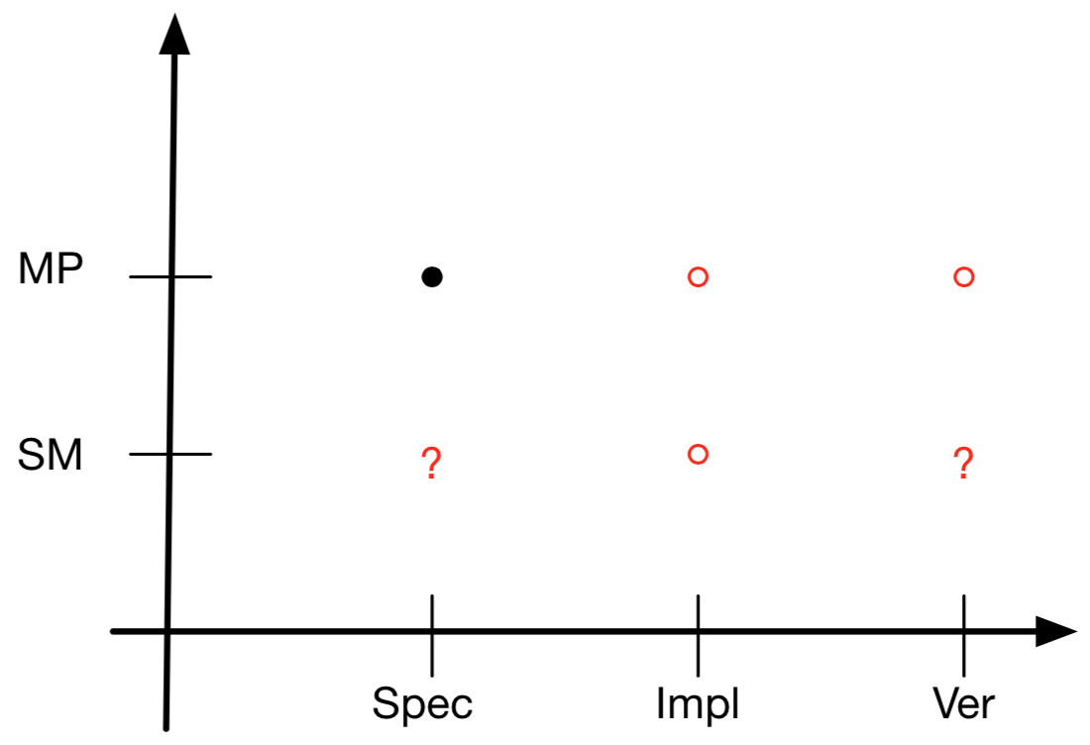
Spectrum

Slide 16
Research goal
If we were to apply any meaningful combination of the above mentioned approaches to software development
Do we get a full-fledged framework for software development?

Slide 17
Example
Specification: Prime Event Structrure
Implementation: Reversible Parallel programs
Verification: Event Identifiers Logic

Slide 18
Open questions 1
Specification: Reversible Prime Event Structrure
Implementation: Reversible Parallel programs
Verification: Event Identifiers Logic
How can we map a program execution into a RPES?
How can we extend EIL to query such structures?
e.g. what is the minimal cause of a certain event ?

Slide 19
Open questions 2
Starting from a program specification / trace
How can we generate reversible tests?
How can tests be transformed into logic formulae?

Slide 20
Open question 3
Record / Replay
No techniques for CC record-replay and trace-compression
How can we record an execution and compress it?
we can record a faulty execution of a beta program and debug it later on
from the faulty trace we can automatically generate tests to see whether the bug is solved
When two traces are equivalent?
How we can compress trace to save time (while recording) and space?

Slide 21
Open question 4
So far reversible debuggers use a fully reversible semantics of the source language
You have to hack the semantics of the VM/interpreter in order to embedd
History logging
Backward execution

Slide 22
Open question 4
Can’t we exploit built in mechanisms of the soure language?
Can we build a debugging facility on top of the Erlang supervision model?
Ability to start / stop/ restart actors
Ability to query the status of actors

Slide 23
Open questions 5
Any other questions?

