Slide 1
Causal-Consistent Reversibility in a Tuple-Based Distributed Language
Ivan Lanese
Computer Science Department
University of Bologna/INRIA
Italy
Joint work with Elena Giachino, Claudio Mezzina and Francesco Tiezzi

Slide 2
Reversing different languages
In principle we would like to take any language and automatically build its causal-consistent reversible extension
Not trivial
Try from Phillips et al. [FoSSaCS 2006] very limited
Less ambitious: understand the interplay between causal-consistent reversibility and various constructs and language features
We put our techniques at work on a language featuring some constructs not considered in past works

Slide 3
Map of the talk
Klaim
Uncontrolled reversibility
The roll operator
Conclusions

Slide 4
Map of the talk
Klaim
Uncontrolled reversibility
The roll operator
Conclusions

Slide 5
Klaim
Coordination language based on distributed tuple spaces
Linda operations for creating and accessing tuples
Tuples accessed by pattern matching
Klaim nets composed by distributed nodes containing processes and data (tuples)
We consider a subset of Klaim called μKlaim

Slide 6
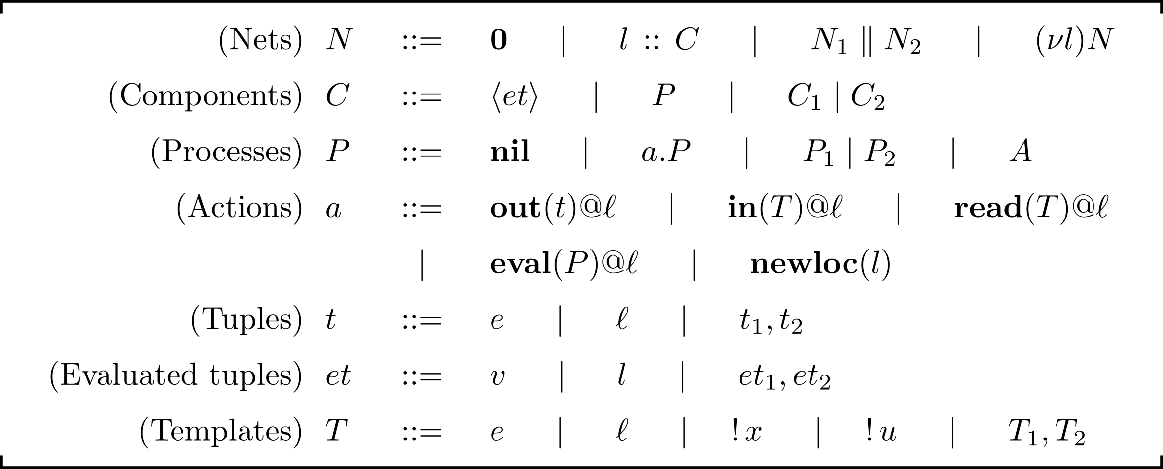
μKlaim syntax

Slide 7
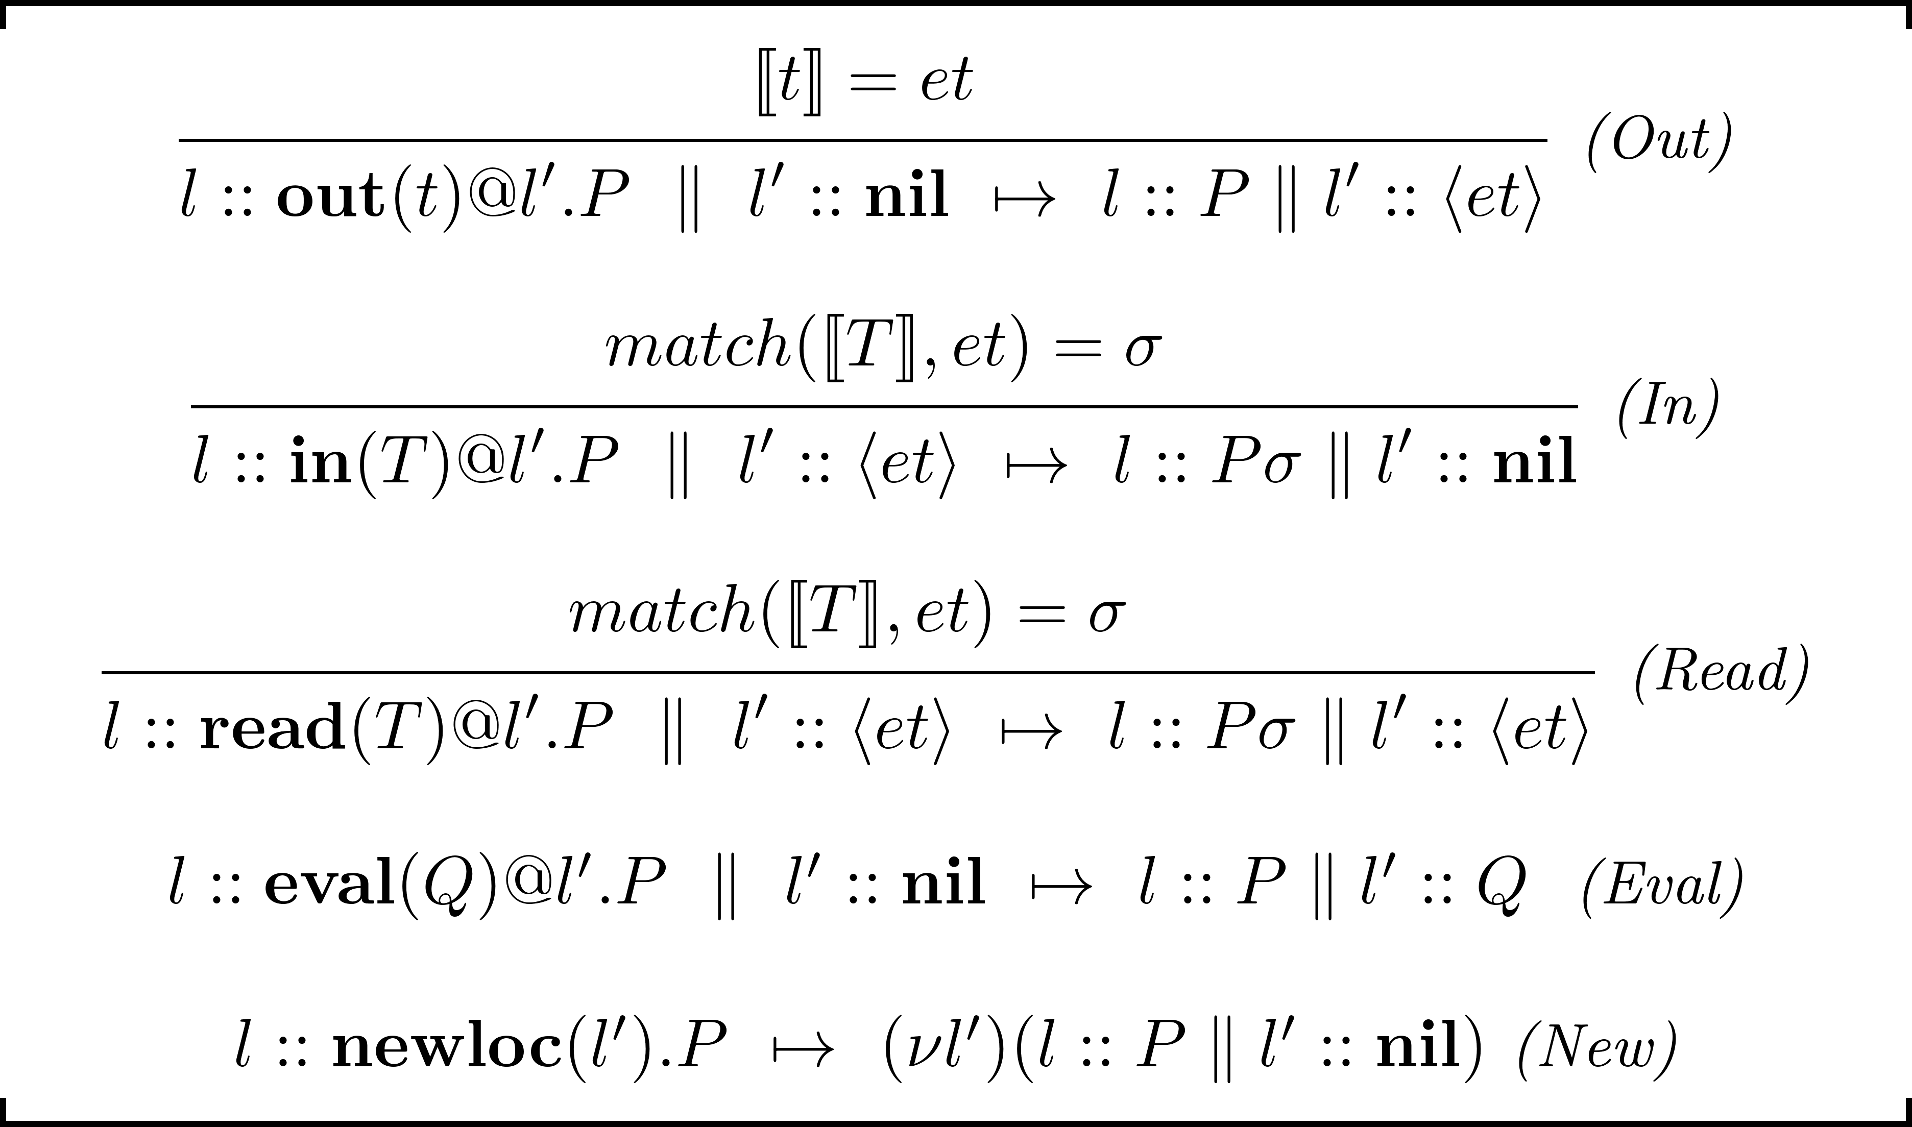
μKlaim semantics

Slide 8
Map of the talk
Klaim
Uncontrolled reversibility
The roll operator
Conclusions

Slide 9
Making μKlaim reversible
We want to apply the technique used for HOπ to μKlaim
We call RμKlaim the resulting language
Some new problems arise
Read dependencies
Two reads on the same tuple should not create dependences
If the out creating the tuple is undone then reads on the tuple should be undone too
Localities
Localities are now resources and establish dependences
To undo a newloc one has to undo all the operations on the created locality

Slide 10
RμKlaim syntax

Slide 11
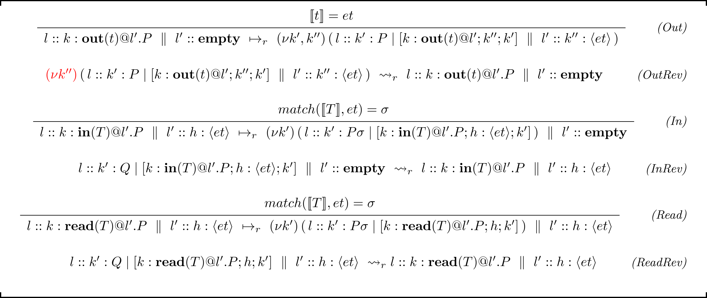
RμKlaim semantics – tuple operators

Slide 12
RμKlaim semantics – distribution operators

Slide 13
Example

Slide 14
Properties
The forward semantics of RμKlaim follows the semantics of μKlaim
The Loop Lemma holds
RμKlaim is causally consistent

Slide 15
Concurrency in RμKlaim
Two transitions are concurrent unless
They use the same resource
At least one transition does not use it in read-only modality
Resources defined by function λ on memories
Read uses the tuple in read-only modality
All primitives but newloc use the locality name in read-only modality

Slide 16
Map of the talk
Klaim
Uncontrolled reversibility
The roll operator
Conclusions

Slide 17
Controlling reversibility
Uncontrolled reversibility is not suitable for programming
We use reversibility to define a roll operator
To undo a given past action
And all its consequences
We call CRμKlaim the extension of μKlaim with roll

Slide 18
CRμKlaim syntax

Slide 19
Example
From
We get
When we undo the out we need to restore the in

Slide 20
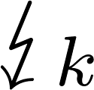
CRμKlaim semantics
M is complete and depends on k
N_{t}: if the undone action is an in I should release the tuple
N_{l}: I should not consume the roll locality, unless created by the undone computation
N : resources consumed by the computation should be released

Slide 21
Results
CRμKlaim is a controlled version of RμKlaim
It inherits all its properties

Slide 22
Map of the talk
Klaim
Uncontrolled reversibility
The roll operator
Conclusions

Slide 23
Summary
We defined uncontrolled and controlled causal-consistent reversibility for μKlaim
Two main features taken into account
Read dependences
Localities

Slide 24
Future work
Part of HOπ theory not yet transported to μKlaim
Behavioral theory
Alternatives
Encoding of the reversible language in the basic one
Would allow to exploit Klaim implementations
Low-level controlled semantics
The killer application may be in the field of STM
Relation between
Definition of concurrent transitions in uncontrolled reversibility
The causality relation used in controlled reversibility

Slide 25
End of talk
Thanks!
Questions?

