Slide 1

Behavioural Verification of Distributed Components
Ludovic Henrio and Eric Madelaine
ICE 2013 - Florence

Slide 2
Agenda
A Distributed Component Model
Behavioural Specification
Verification Platform
Status, conclusion, and perspectives

Slide 3
What are Components?
Primitive component
Business code
Client
/ output
Server
/ input

Slide 4

What are Components?
Composite component
Primitive component
Primitive component
Business code
Business code
Grid Component Model (GCM)
An extension of Fractal for Distributed computing
ProActive/GCM
An implementation based on active objects

Slide 5
A Primitive GCM Component
CI
CI.foo(p)
Primitive components communicating by asynchronous requests on interfaces
Components abstract away distribution and concurrency
In ProActive/GCM a primitive component is an active object
Notes:
----- Notes de la réunion (7/16/12 11:21) -----
enlever requete1
1

Slide 6
Futures for Components
1
2
f=CI.foo(p)
……….
3
g=f+3
g=f+3
Component are independent entities
(threads are isolated in a component)
+
Asynchronous requests with results
⬇
Futures are necessary
Notes:
Ajouter 1 2 3

Slide 7
First-class Futures
…
…
…
f=CI.foo(p)
CI.foo(f)
CI.foo(f)
In GCM/ProActive,
1 Component (data/code unit)
= 1 Active object (1 thread = unit of concurrency)
= 1 Location (unit of distribution)

Slide 8
Collective interfaces: a core GCM originality
One-to-many = multicast
Many-to-one = gathercast
Distribution and synchronisation/collection policies for invocation and results
Composite component
Primitive component
Primitive component
Business code
Business code
Primitive component
Business code
Primitive component
Business code

Slide 9
Agenda
A Distributed Component Model
Behavioural Specification
Verification Platform
Status, conclusion, and perspectives

Slide 10
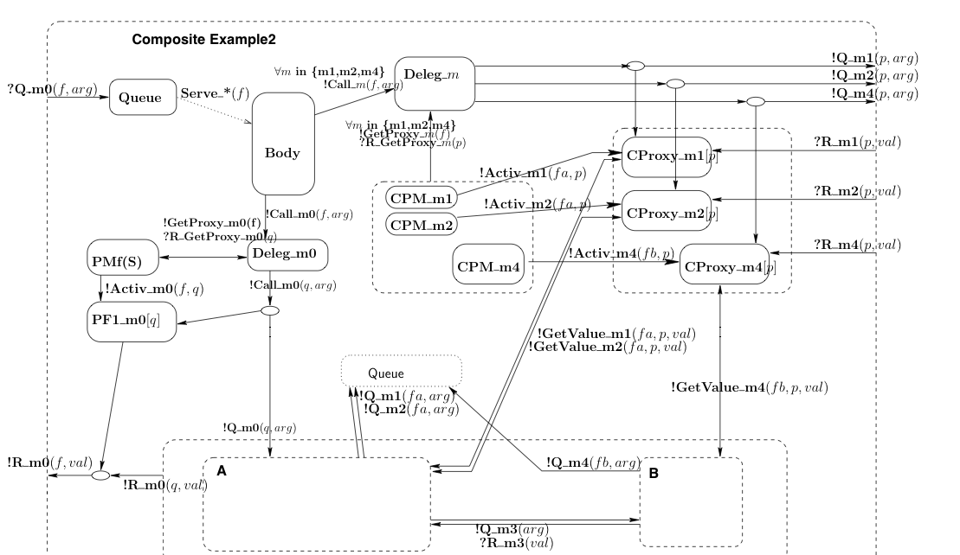
How to ensure the correct behaviour of a component application?
Our approach: behavioural specification
Service methods
Service methods
pNets:
Trust the implementation step
Or static analysis
Generate correct (skeletons of) components
(+static and/or runtime checks)
Behavioural Models for Distributed Fractal Components Antonio Cansado, Ludovic Henrio, and Eric Madelaine - Annals of Telecommunications - 2008

Slide 11
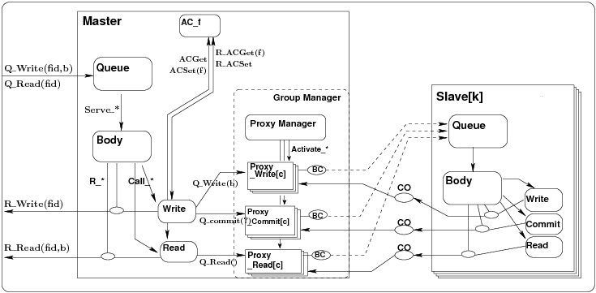
Full picture: a pNet
Support for parameterised
families
?Q_Write(x)
!Q_Write(b)
Synchronisation vectors

Slide 12
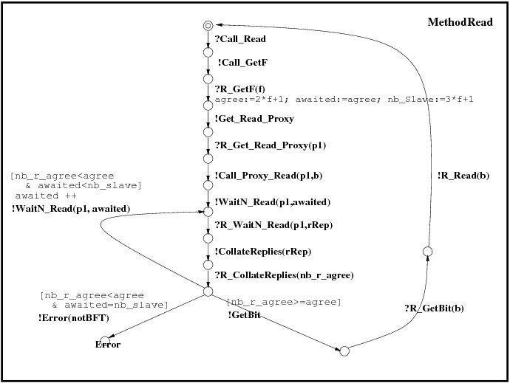
Basic pNets: parameterised LTS
Labelled transition systems, with:
Value passing
Local variables
Guards….
(~value passing CCS, LOTOS)
Can be written as a UML state machine
Eric MADELAINE

Slide 13
Complex synchronisations in pNets:
Many-to-many
Synchronisation of any number of processes at the same time

Slide 14
Complex synchronisations in pNets: indexing
A parameter can be used to index inside a structure
Indexation in family of future proxies
  Many to-many synchronisation with indexing
Recycle local future proxy
Update local future proxy
Transmit reply to subcomponent k
Global action

Slide 15
Agenda
A Distributed Component Model
Behavioural Specification
Verification Platform
Status, conclusion, and perspectives

Slide 16
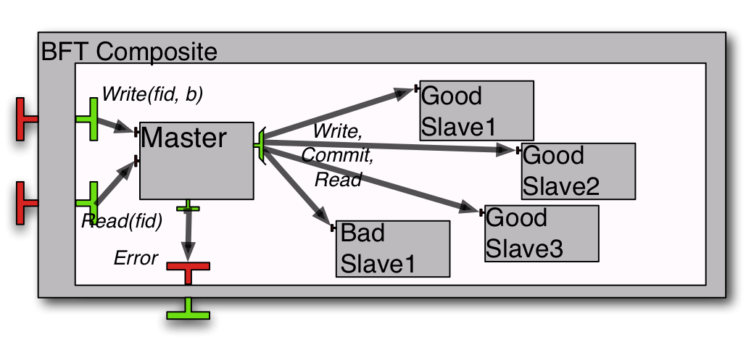
Use-case: Fault-tolerant storage
1 multicast interface sending write/read requests to all slaves.
the slaves reply asynchronously, the master only needs enough coherent answers to terminate
Verifying Safety of Fault-Tolerant Distributed Components
Rabéa Ameur-Boulifa, Raluca Halalai, Ludovic Henrio, and Eric Madelaine - FACS 2011

Slide 17
BFT pNet: focus on multicast

Slide 18
Properties proved (on the case study)
Reachability(*):
1- The Read service can terminate
 fid:nat among {0...2}. ∃ b:bool. <true* . {!R_Read !fid !b}> true
2- Is the BFT hypothesis respected by the model ?
< true* . 'Error (NotBFT)'> true
Inevitability:
After receiving a Q_Write(f,x) request, it is (fairly) inevitable that the Write services terminates with a R_Write(f) answer, or an Error is raised.
Functional correctness:
After receiving a ?Q_Write(f1,x), and before the next ?Q_Write, a ?Q_Read requests raises a !R_Read(y) response, with y=x
(*) Model Checking Language (MCL), Mateescu et al, FM’08
Prove (safety and liveness)
generic properties like absence of deadlock
or properties specific to the application logic

Slide 19
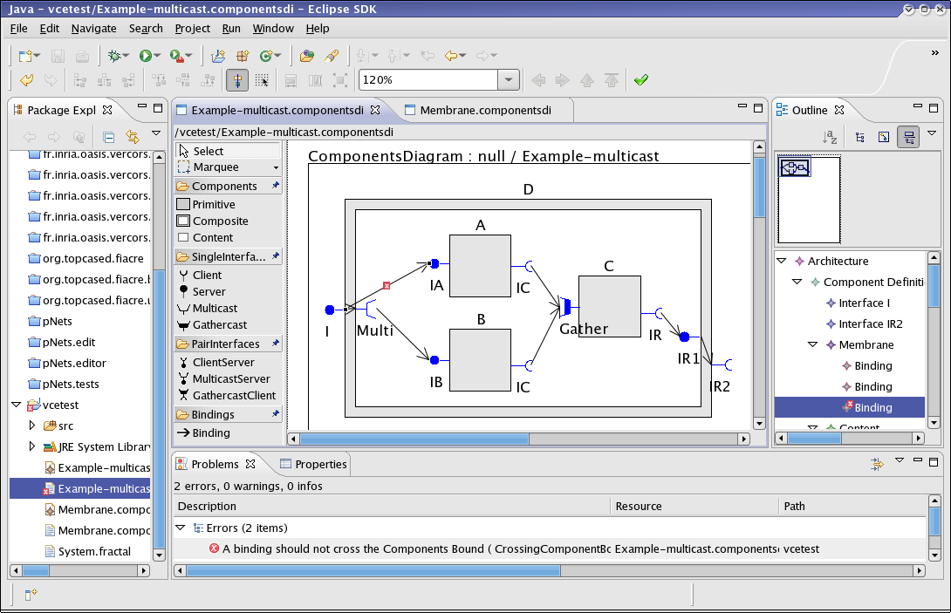
Tool Architecture
Vercors Editors:
ADL ++
Interfaces
Behaviors
Properties
*.fractal
Abs
CADP:
Caesar.open
Distributor
Exp.open
Evaluator
Behav. Sem.
pNets
N2F
LNT
exp
svl++
MCL
Diagnostic visualisation
Currently: production of the CADP input formats; only partially (~50%) available.
Goal: full automatisation

Slide 20
Agenda
A Distributed Component Model
Behavioural Specification
Verification Platform
Status, conclusion, and perspectives

Slide 21
Conclusion
A component model made of autonomous asynchronous components
  Request/future comunications
  One-to-many and many-to-one communications + MxN
A formalism for representing the behavioural semantics of a system
The translation between the two,
  completely formalised,
  Partially implemented.

Slide 22
Recent advances in behavioural specification for GCM
Scaling-up : gained orders of magnitude by a combination of:
  data abstraction,
  compositional and contextual minimization,
  distributed state-space generation.
Biggest intermediate model:
5M states / estimated brute force: ~ 10³²
pNets: 2004-2008
CoCoME: hierarchical & synchronous
FACS’08: 1st class futures
WCSI’10: group communication
FACS’11:
GCM & multicast interfaces
Application to BFT
Ongoing work
Reconfiguration...

Slide 23
Correct component reconfiguration
Towards safety and autonomicity
Verify reconfiguration
procedures
Safe adaptation procedures
as a solid ground for
autonomic applications
Some directions:
  Parameterized topologies (not only master-slave): ADL[N] ; behavioural specification (pNets) ; reconfiguration primitives
  Theorem proving might help (prove general properties)

Slide 24
Correct component reconfiguration
Towards safety and autonomicity
Verify reconfiguration
procedures
Safe adaptation procedures
as a solid ground for
autonomic applications
Some directions:
  Parameterized topologies (not only master-slave): ADL[N] ; behavioural specification (pNets) ; reconfiguration primitives
  Theorem proving might help (prove general properties)
[N]

Slide 25
THANK YOU ! ☺
See our webpages for technical papers, tools, and usecases
http://www-sop.inria.fr/members/Eric.Madelaine/
eric.madelaine@inria.fr
http://www-sop.inria.fr/oasis/personnel/Ludovic.Henrio/
ludovic.henrio@cnrs.fr

Slide 27
State-space generation workflow
MQueue.fcr
MBody.fcr
WriteProxy.fcr
Flac +
Distributor
+ Minimize
Master Queue
Master Body
…
Write Proxy
MQueue.bcg
MQueue.bcg
WriteProxy.bcg
Build product
Master.exp
(Hide/Rename)
Minimize
Master.exp
…
Notes:
How the case study was split into a workflow
that can be run as a ProActive Scheduler job on PacaGrid
27

Slide 28
But what is a Good size for a
(primitive) Component?
Not a strict requirement, but somehow imposed by the model design
According to CCA or SCA, a service (a component contains a provided business function)
According to Fractal, a few objects
According to GCM, a process
In GCM/ProActive,
1 Component (data/code unit)
= 1 Active object (1 thread = unit of concurrency)
= 1 Location (unit of distribution)
GCM: A Grid Extension to Fractal for Autonomous Distributed Components - F. Baude, D. Caromel, C. Dalmasso, M. Danelutto, V. Getov, L. Henrio, C. Pérez - Annals of Telecom. - 2008

Slide 29
First-class Futures and Hierarchy
return C1.foo(x)
… … …
Without first-class futures, one thread is systematically blocked in the composite component.
A lot of blocked threads
In GCM/ProActive ➔ systematic deadlock

Slide 30
Back to the case study
Hypotheses:
The master is reliable: this simplifies the 3-phases commit protocol, and avoid the consensus research phase.
The underlying middleware ensures safe communications:
  faulty components only respond to their own requests
  communication order is preserved.
To tolerate f faults we use 3f+1 slaves, and require 2f+1 agreeing answers, as in the usual BFT algorithms.
NB: Here f+1 would be sufficient

Slide 31
Generation of state-space
Taming state-space explosion:
Data abstraction (through abstract interpretation):
integers => small intervals
arrays => open question.
Partitioning and minimizing by bisimulation + context specification
Distributed verification.
Only partially available
(state-space generation, but no M.C.).
Notes:
Size problems usually occur essentially during debugging phases…

Slide 32
Compositional + Distributed
State-space generation
Abstract model:
f=1, (=> 4 slaves), |data|= 2, |proxies|=3*3,
|client requests|=3
Master queue size = 2
~100 cores, max 300 GB RAM
System part sizes (states/transitions):
Queue | Largest intermediate | Master | Good Slave | Global |  | Time
237/3189 | 524/3107 | 5M/103M | 5936/61K | 34K/164K |  | 59’
Estimated brute force state spaces :
10¹⁸ | 6.10³ | ~ 10³²

