Slide 1
Amending Choreographies
Ivan Lanese
Computer Science Department
University of Bologna/INRIA
Italy
Joint work with Fabrizio Montesi and Gianluigi Zavattaro

Slide 2
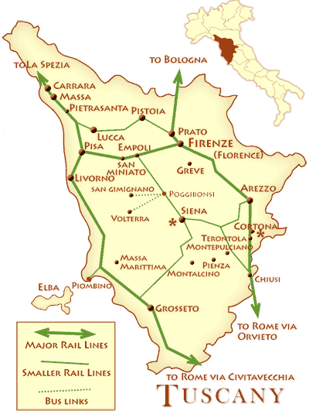
Map of the talk
Choreographies
Amending choreographies
Conclusions

Slide 3
Map of the talk
Choreographies
Amending choreographies
Conclusions

Slide 4
Choreographies
Allow to describe the behavior of a distributed communicating system at the very abstract level
Composed by interactions of the form $a→b:o$
Using different operators
Sequential composition ;
Parallel composition ||
Nondeterministic choice +
There are approaches extending choreographies with additional information (data, recursion, ...)
Very similar to global types in multiparty session types

Slide 5
Choreography projection
Allows to automatically derive from a choreography the description of the behavior of each participant
Nearer to the implementation
Preserves the semantics: when interacting, the participants behave as specified by the choreography

Slide 6
Participants description
Locations corresponding to participants, containing their code
Basic operations: input $o$ and output $\overline{o}$
Composed using
sequential composition ;
parallel composition |
nondeterministic choice +

Slide 7
Examples
The projection of $a→b:o;b→c:o′$ is ${[\overline{o}]}_{a} ||{ \left[o;\overline{o^{′}}\right]}_{b} ||{ [o^{′}]}_{c}$
The projection of $a→b:o;c→d:o′$ is ${[\overline{o}]}_{a} ||{ \left[o\right]}_{b} ||{{ [\overline{o^{′}}]}_{c} || [o^{′}]}_{d}$
Not well-behaved

Slide 8
Well-behaved choreographies
Syntactic conditions ensure choreographies are well-behaved
Conditions depend on
Synchronous or asynchronous semantics
For asynchronous, whether send, receive or both are observed

Slide 9
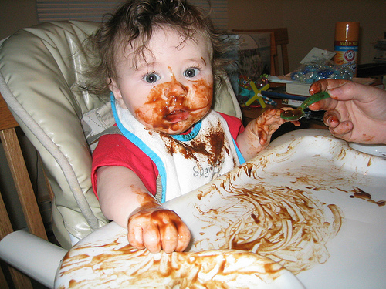
Non well-behaved choreographies
What to do when choreographies are not well-behaved?
We transform them automatically into well-behaved ones
According to the strictest of the conditions
Preserving the intended semantics
Weak traces

Slide 10
Map of the talk
Choreographies
Amending choreographies
Conclusions

Slide 11
Choreography issues
Connectedness for sequence
Two roles do not agree on when the first term of a sequential composition has been completed
Unique points of choice
Two roles do not agree on which branch of a choice has been taken
Causality safety
A send on an operation is not received by the intended target, but by another receiver

Slide 12
Our approach
For each issue we show a pattern for solving it
Preserving weak traces
We compose all the patterns into a unique algorithm solving all the issues

Slide 13
transI and transF
Auxiliary definition needed for the formalization
transI: set of interactions enabled in a term
transF: set of interactions that may be the last one to be executed in the term
Can be defined by structural induction on the term

Slide 14
Connectedness for sequence issue
$C=a→b:o;c→d:o′$
$proj\left(C\right)={[\overline{o}]}_{a} ||{ \left[o\right]}_{b} ||{{ [\overline{o^{′}}]}_{c} || [o^{′}]}_{d}$
$c$ does not know when $b$ has received the message
Avoided if for each subterm of the form C’;C’’
There is a participant that knows when C’ ends which regulates when C’’ starts
Formally, for each $a→b:o ∈$ transF(C’), each $c→d:o^{′}∈$ transI(C’’) we have $b=c$

Slide 15
Connectedness for sequence pattern
Introduce a new coordinator role e
Checks when C’ ends
Allows C’’ to start
Replace each $a→b:o ∈$ transF(C’) with $a→b:o;b→e:o^{∗1}$
Replace each c$→d:o′ ∈$ transI(C’’) with $e→c:o^{∗2};c→d:o′$
Operations with * are private, not visible in weak traces

Slide 16
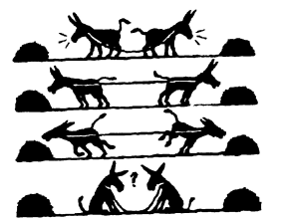
Unique points of choice issue (1)
$C=a→b:o+c→d:o′$
$proj\left(C\right)={[\overline{o}+1]}_{a} ||{ \left[o+1\right]}_{b} ||{{ [1+\overline{o^{′}}]}_{c} || [1+o^{′}]}_{d}$
Avoided if for each subterm C’+C’’
There is a participant deciding which branch to take and notifying all the others
Formally, for each $a→b:o ∈$ transI(C’+C’’), $a$ is the same
Role $a$ decides which branch to take

Slide 17
Unique points of choice issue (2)
$C_{1}=(a→b:o+a→c:o^{′});b→c:o′′$
$proj\left(C_{1}\right)={[\overline{o}+\overline{o′}]}_{a} ||{ \left[\left(o+1\right);\overline{o′′}\right]}_{b} ||{ [\left(1+o^{′}\right);o′′]}_{c}$
Avoided if for each subterm C’+C’’
C’ and C’’ have the same set of roles
All the involved roles do something in each alternative
No projection with one branch $1$ and one branch non $1$

Slide 18
Unique points of choice pattern
Introduce a new coordinator role e making the choice
Replace each $a→b:o ∈$ transI(C’+C’’) with $e→a:o^{∗1};a→b:o$
If role $f$ occurs in C’ but not in C’’ then transform C’’ into $C^{′′}||e→f:o^{∗3}$
And vice versa

Slide 19
Causality safety issue
Avoided if for each pair of interactions $a→b:o$ and $c→d:o$ on the same operation
If the send at $a$ may trigger, the receive at $d$ is not enabled
If the send at $c$ may trigger, the receive at $b$ is not enabled
We need either a causal dependence or a conflict
Different approaches depending on the top-level operator in the smallest term containing both the interactions

Slide 20
Sequential causality safety issue
$C=a→b:o;b→c:o$
$proj\left(C\right)={[\overline{o}]}_{a} ||{ \left[o;\overline{o}\right]}_{b} {|| [o]}_{c}$
The send at $a$ may be get by the receive at $c$
May happen in terms C’;C’’ with interactions $a→b:o$ in C’ and $c→d:o$ in C’’
If the term satisfies connectedness for sequence there is a dependence between the receive at $b$and the send at $c$
We add the missing dependence by replacing $c→d:o$ with $c→d:o^{∗1};d→c:o^{∗2};c→d:o$

Slide 21
Choice causality safety issue
$C=\left(a→b:o^{′};b→a:o;a→c:o^{′′}\right)+$ $(a→c:o;c→b:o^{′})$
$proj\left(C\right)={[\overline{o^{′}};o;\overline{o′′}+\overline{o}]}_{a} ||{ \left[o^{′};\overline{o}+o′\right]}_{b} {|| [o^{′′}+o;\overline{o′}]}_{c}$
The message on $o$ to $a$ may be get by $c$
The problem is that $c$ has not been notified about the choice yet
We add the missing dependence by replacing $a→c:o$ with $a→c:o^{∗1};c→a:o^{∗2};a→c:o$

Slide 22
Parallel causality safety
$C=a→b:o||c→d:o$
$proj\left(C\right)={[\overline{o}]}_{a} ||{ \left[o\right]}_{b} ||{{ [\overline{o}]}_{c} || [o]}_{d}$
The send at $a$ may be get by the receive at $d$
Parallel causality safety cannot be amended by adding (private) interactions only

Slide 23
Choreography normal form
A choreography is in normal form if it is $\sum_{i}{a_{i}→b_{i}:o_{i};C_{i}}$ where $C_{i}$ is in normal form

Slide 24
Expansion law
We can use the expansion law to put choreographies in normal form $\left(\sum_{i}{a_{i}→b_{i}:o_{i};C_{i}}\right)||\left(\sum_{i}{a_{j}→b_{j}:o_{j};C_{j}}\right)=$ $\sum_{i}{a_{i}→b_{i}:o_{i};\left(C_{i}||\sum_{i}{a_{j}→b_{j}:o_{j};C_{j}}\right)}+$ $\sum_{j}{a_{j}→b_{j}:o_{j};\left(C_{j}||\sum_{i}{a_{i}→b_{i}:o_{i};C_{i}}\right)}$
This solves parallel causality safety issues

Slide 25
Amending choreographies
We can compose the patterns above to transform any choreography into a well-behaved one
Apply the pattern to solve parallel causality issues
Apply the pattern for connectedness for sequence and unique points of choice
Apply the pattern for sequential and choice causality safety
All patterns applied from smallest subterms to largest subterms

Slide 26
Final result
The transformation preserves weak traces and makes the choreography well-behaved
For synchronous semantics
For asynchronous semantics, observing either send, or receive, or both
The projection of a well-behaved choreography preserves traces
The projection of the transformed choreography is weak trace equivalent to the original choreography

Slide 27
Map of the talk
Choreographies
Amending choreographies
Conclusions

Slide 28
Summary
An automatic technique for transforming a given choreography into a projectable one
The transformation preserves weak traces
All patterns but the one for parallel causality safety based on adding auxiliary interactions
The pattern for parallel causality safety reduces the degree of concurrency
Patterns are applied only when and where they are needed

Slide 29
Future work
Extend the approach to deal with other features
Recursion
Data
Exploiting choreography amending for choreography composition
Adaptive choreographies

Slide 30
End of talk
Thanks!
Questions?

