Slide 1
Causal-Consistent Reversibility in a Tuple-Based Distributed Language
Francesco Tiezzi
IMT Advanced Studies Lucca
CINA
2nd Gen. Meeting
19 February 2014
Bologna
Joint work with Elena Giachino,
Ivan Lanese and Claudio Mezzina

Slide 2
Map of the talk
Reversibility
Klaim
Uncontrolled reversibility in Klaim
Controlling reversibility: roll operator
Conclusions

Slide 3
What is reversibility?
The possibility of executing a computation both in the standard, forward direction, and in the backward direction, going back to a past state
Reversibility everywhere
chemistry/biology
quantum computing
state space exploration
…

Slide 4
Our aim
We want to exploit reversibility for programming reliable concurrent/distributed systems
To make a system reliable we want to avoid “bad” states
If a bad state is reached, reversibility allows to go back to some past state
Understanding reversibility is the key to
Understand existing patterns for programming reliable systems, e.g. checkpointing, rollback-recovery, transactions, …
Combine and improve them
Develop new patterns

Slide 5
Reverse execution of a sequential program
Recursively undo the last step
Computations are undone in reverse order
To reverse A;B reverse B, then reverse A
We want the Loop Lemma to hold
From state S, doing A and then undoing A should lead back to S
From state S, undoing A (if A is in the past) and then redoing A should lead back to S

Slide 6
Different approaches to reversibility
Undoing computational steps, not necessarily easy
Computation steps may cause loss of information
X=5 causes the loss of the past value of X
Considering languages which are reversible
Featuring only actions that cause no loss of information
Taking a language which is not reversible and make it reversible
One should save information on the past configurations
X=5 becomes reversible by recording the old value of X

Slide 7
Reversibility and concurrency
In a sequential setting, recursively undo the last action
Which is the last action in a concurrent setting?
Many possibilities
For sure, if an action A caused an action B, A could not be the last one
Causal-consistent reversibility: recursively undo any action whose consequences (if any) have already been undone

Slide 8
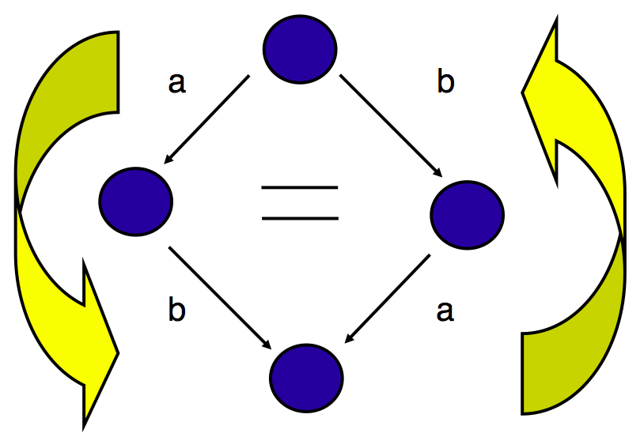
Causal-consistent reversibility

Slide 9
Reversibility and concurrency
Causal-consistent reversibility allows one to distinguish non-determinism from concurrency
Two sequential actions whose order is chosen nondeterminstically should be reversed in reverse order
Two concurrent actions can be reversed in any order
Choosing an interleaving for them is an arbitrary choice
It should have no impact on the possible reverse behaviors

Slide 10
Map of the talk
Reversibility
Klaim
Uncontrolled reversibility in Klaim
Controlling reversibility: roll operator
Conclusions

Slide 11
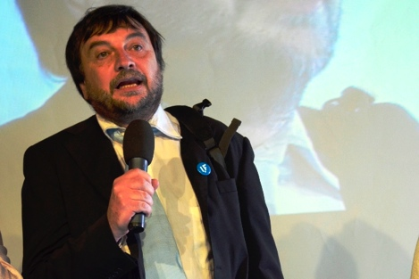
Klaim
Coordination language based on distributed tuple spaces
Linda operations for creating and accessing tuples
Tuples accessed via pattern-matching
Klaim nets composed by distributed nodes containing processes and data (tuples)
We consider a subset of Klaim called μKlaim

Slide 12
μKlaim syntax

Slide 13
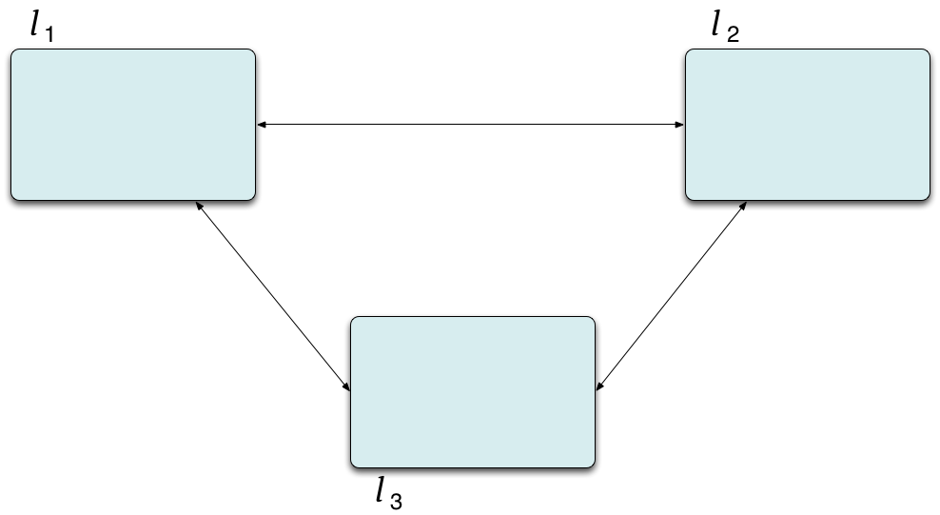
μKlaim syntax

Slide 14
μKlaim syntax

Slide 15
μKlaim syntax

Slide 16
μKlaim syntax

Slide 17
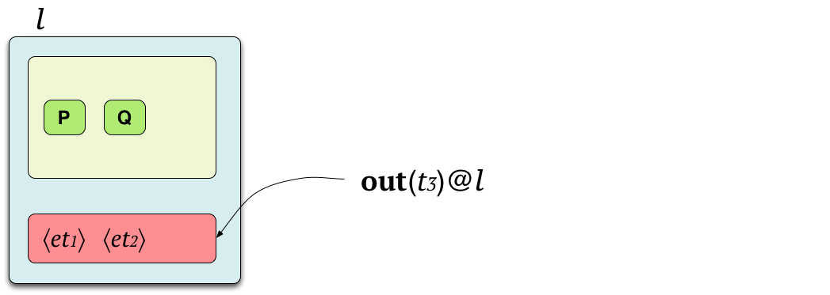
μKlaim syntax

Slide 18
μKlaim syntax

Slide 19
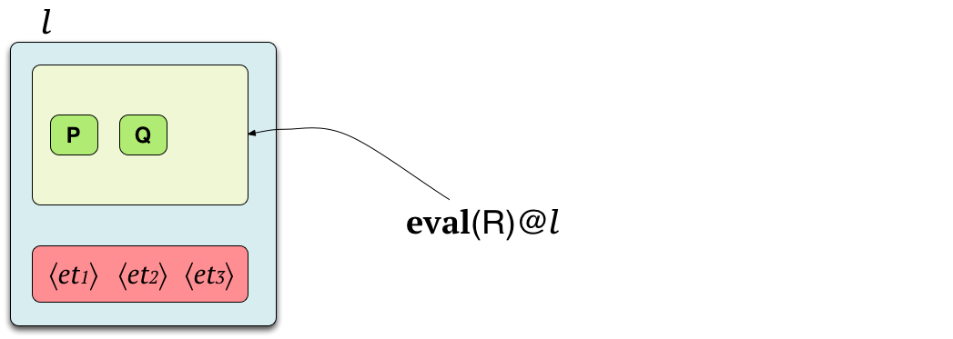
μKlaim syntax

Slide 20
μKlaim syntax

Slide 21
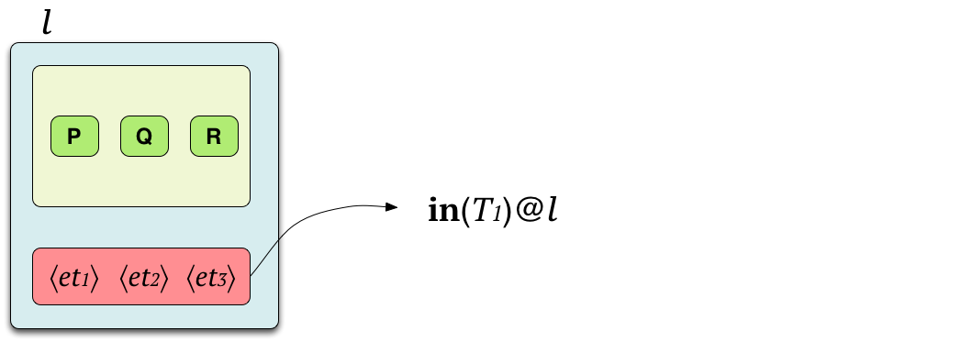
μKlaim syntax

Slide 22
μKlaim syntax

Slide 23
μKlaim syntax

Slide 24
μKlaim syntax

Slide 25
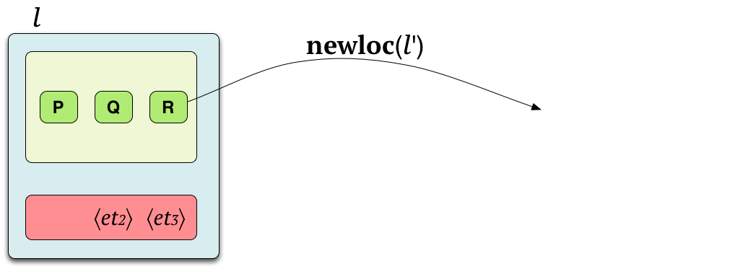
μKlaim syntax

Slide 26
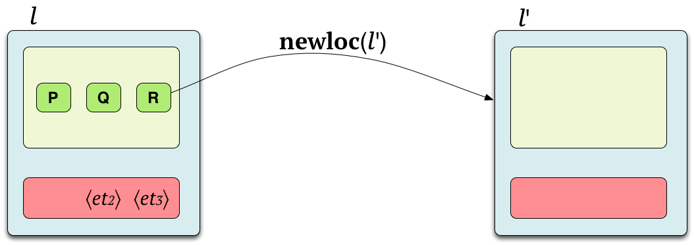
μKlaim syntax

Slide 27
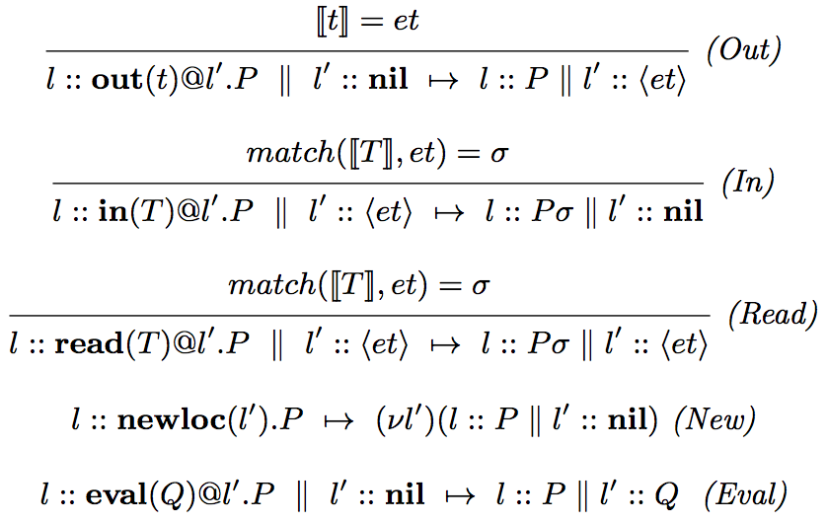
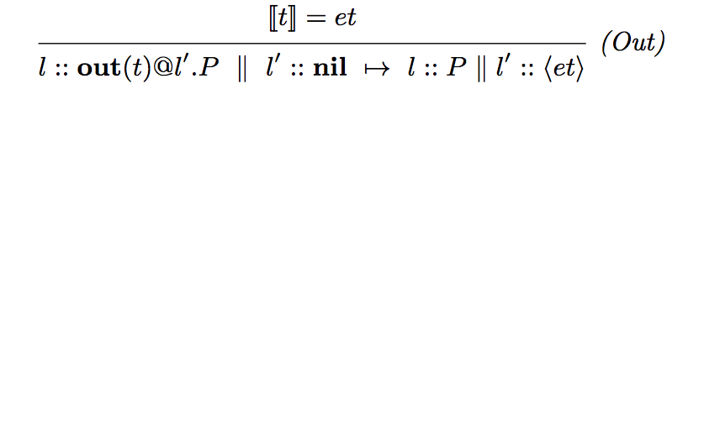
μKlaim semantics

Slide 28
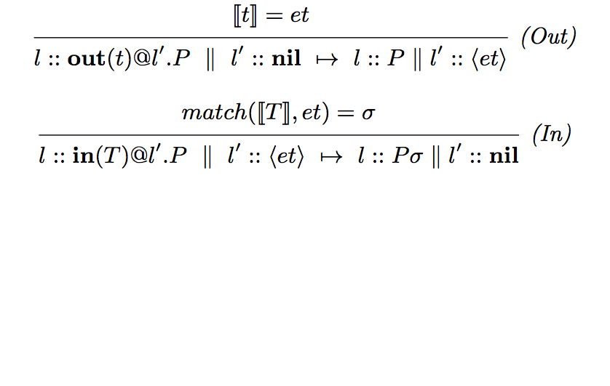
μKlaim semantics

Slide 29
μKlaim semantics

Slide 30
μKlaim semantics
Evaluation-closed relation
A relation is evaluation closed if it is closed under active contexts
N1 ⟼ N1′ implies N1 || N2 ⟼ N1′ || N2 and (νl) N1 ⟼ (νl)N1′
and under structural congruence
N≡M ⟼ M′ ≡N′ implies N ⟼ N′
μKlaim semantics
The μKlaim reduction relation ⟼ is the smallest evaluation-closed relation satisfying the rules in previous slide

Slide 31
Example

Slide 32
Map of the talk
Reversibility
Klaim
Uncontrolled reversibility in Klaim
Controlling reversibility: roll operator
Conclusions

Slide 33
Making μKlaim reversible
We define RμKlaim, an extension of μKlaim allowing: - forward actions, modeling μKlaim actions - backward actions, undoing them
Some new problems arise
Read dependencies
Two reads on the same tuple should not create dependences
If the out creating the tuple is undone then reads on the tuple should be undone too
Localities
Localities are now resources and establish dependences
To undo a newloc one has to undo all the operations on the created locality

Slide 34
RμKlaim syntax

Slide 35
RμKlaim semantics – tuple operators

Slide 36
RμKlaim semantics – tuple operators

Slide 37
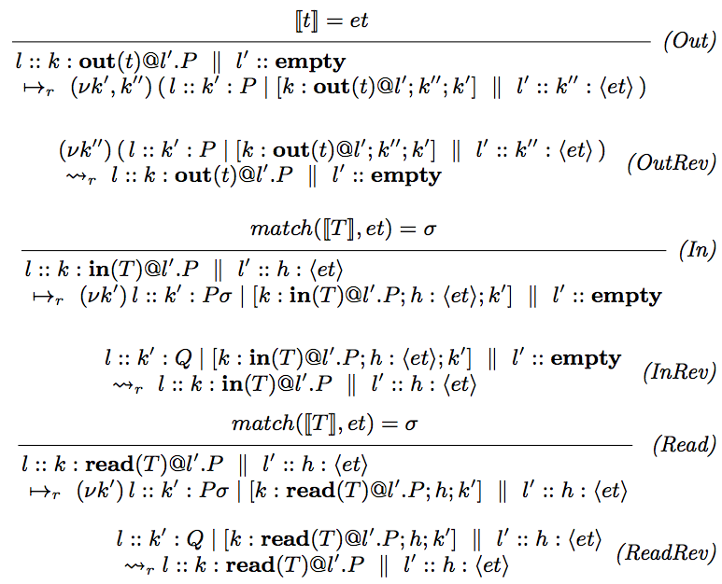
RμKlaim semantics – tuple operators

Slide 38
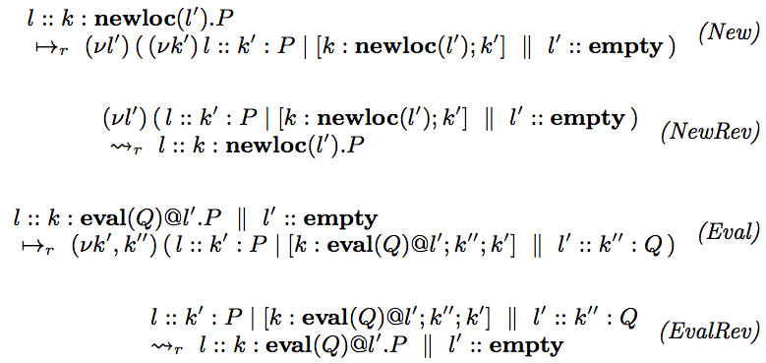
RμKlaim semantics – distribution operators

Slide 39
Example

Slide 40
Example
execute in in l₂
execute out in l₂
execute in in l₃
execute out in l₃

Slide 41
Example
execute in in l₂
execute out in l₂
execute in in l₃
it needs to perform
a backward step
execute out in l₃

Slide 42
Properties
The forward semantics of RμKlaim follows the semantics of μKlaim
The Loop Lemma holds
i.e., each reduction in RμKlaim has an inverse
RμKlaim is causally consistent
same approach of previous works
different technicalities (due to more complex causality structure)

Slide 43
Concurrency in RμKlaim
Two transitions are concurrent unless
They use the same resource
At least one transition does not use it in read-only modality
Resources defined by function λ on memories
Read uses the tuple in read-only modality
All primitives but newloc use the locality name in read-only modality

Slide 44
Causal consistency
Causal equivalence identifies traces that differ only for
swaps of concurrent transitions
simplifications of inverse transitions
Casual consistency: there is a unique way to go from one state to another one up to causal equivalence
causal equivalent traces can be reversed in the same ways
traces which are not causal equivalent lead to distinct nets

Slide 45
Map of the talk
Reversibility
Klaim
Uncontrolled reversibility in Klaim
Controlling reversibility: roll operator
Conclusions

Slide 46
Controlling reversibility
Uncontrolled reversibility is not suitable for programming
We use reversibility to define a roll operator
To undo a given past action
And all its consequences
We call CRμKlaim the extension of μKlaim with roll

Slide 47
CRμKlaim syntax

Slide 48
Example
From
We get
When we undo the out we need to restore the in

Slide 49
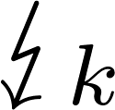
CRμKlaim semantics
M is complete and depends on k
N_{t}: if the undone action is an in, we should release the tuple
N_{l}: we should not consume the roll locality, unless created by the undone computation
N : resources consumed by the computation should be released

Slide 50
Results
CRμKlaim is a controlled version of RμKlaim
It inherits all its properties

Slide 51
Map of the talk
Reversibility
Klaim
Uncontrolled reversibility in Klaim
Controlling reversibility: roll operator
Conclusions

Slide 52
Summary
We defined uncontrolled and controlled causal-consistent reversibility for μKlaim
Two main features taken into account
Read dependences
Localities

Slide 53
Future work
Part of HOπ theory not yet transported to μKlaim
Encoding of the reversible language in the basic one
Would allow to exploit Klaim implementations
Low-level controlled semantics
Alternatives
The killer application may be in the field of STM

Slide 54
Thanks!
Questions?

Slide 55
5th International Workshop on
Modeling and Simulation of
Peer-to-Peer and Autonomic Systems
(MOSPAS 2014)
July 21-25, 2014 - Bologna, Italy
Submission Deadline:
March 11, 2014

