Slide 1
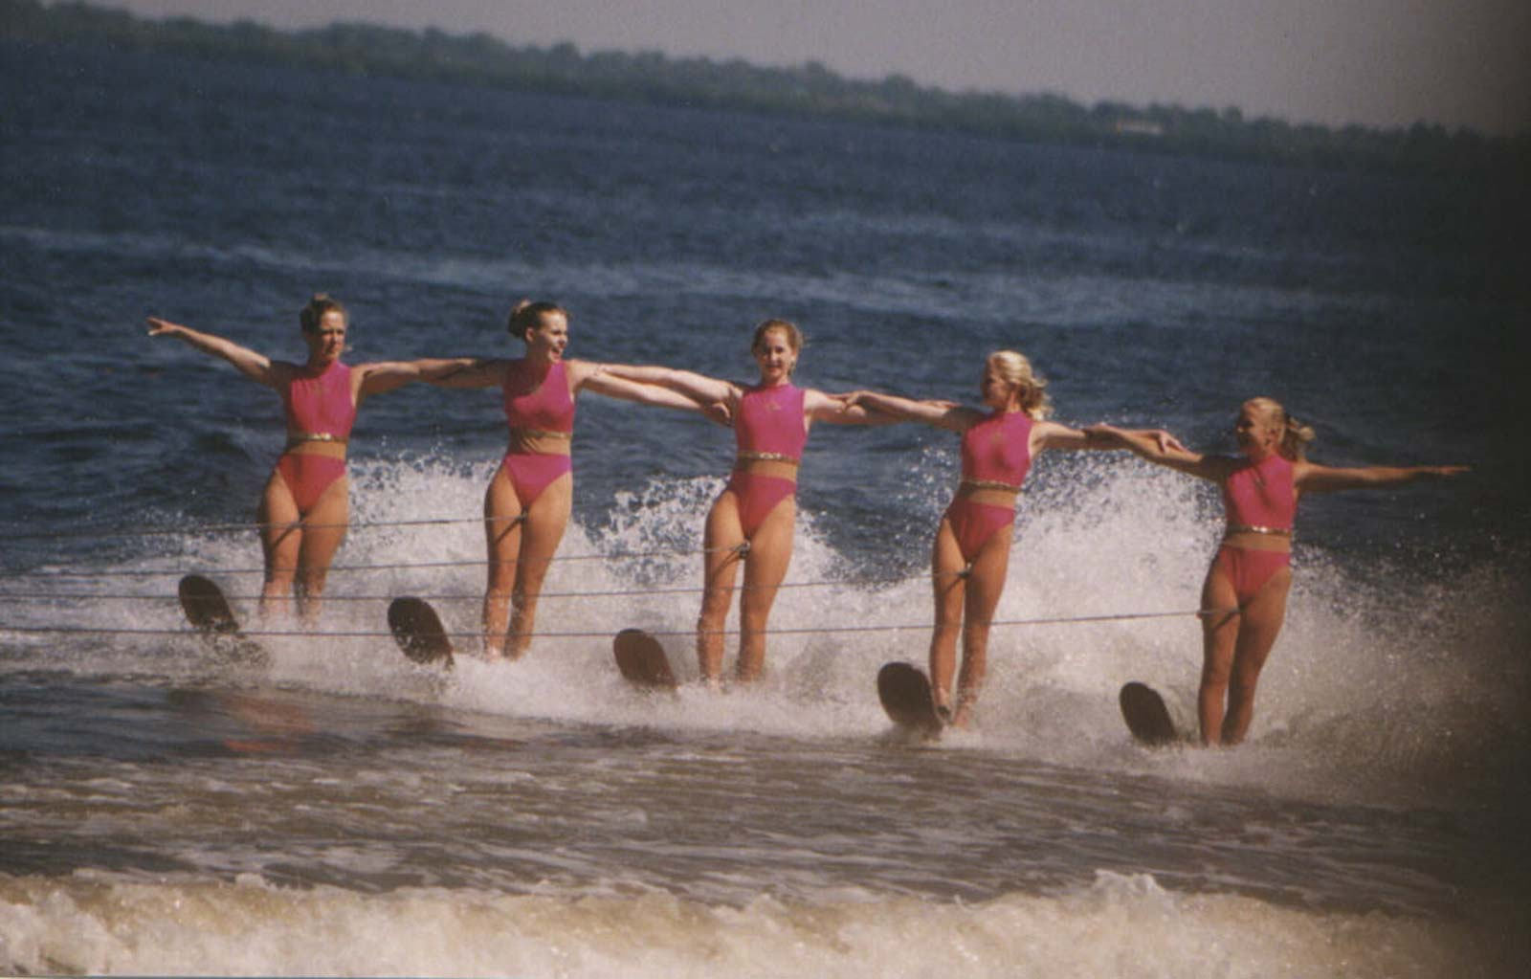
Adaptive choreographies
Ivan Lanese
Computer Science Department
University of Bologna/INRIA
Italy
Joint work with Mila Dalla Preda, Jacopo Mauro and Maurizio Gabbrielli

Slide 2
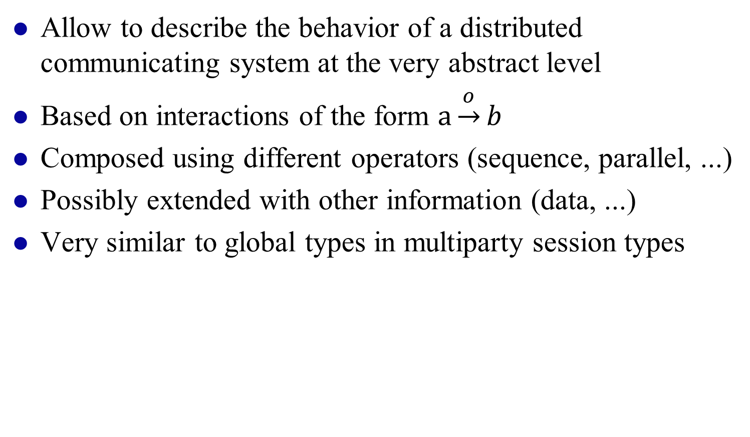
Choreographies
Allow to describe the behavior of a distributed communicating system at the very abstract level
Based on interactions of the form $a\underset{→}{o}b$
Composed using different operators (sequence, parallel, ...)
Possibly extended with other information (data, ...)
Very similar to global types in multiparty session types

Slide 3
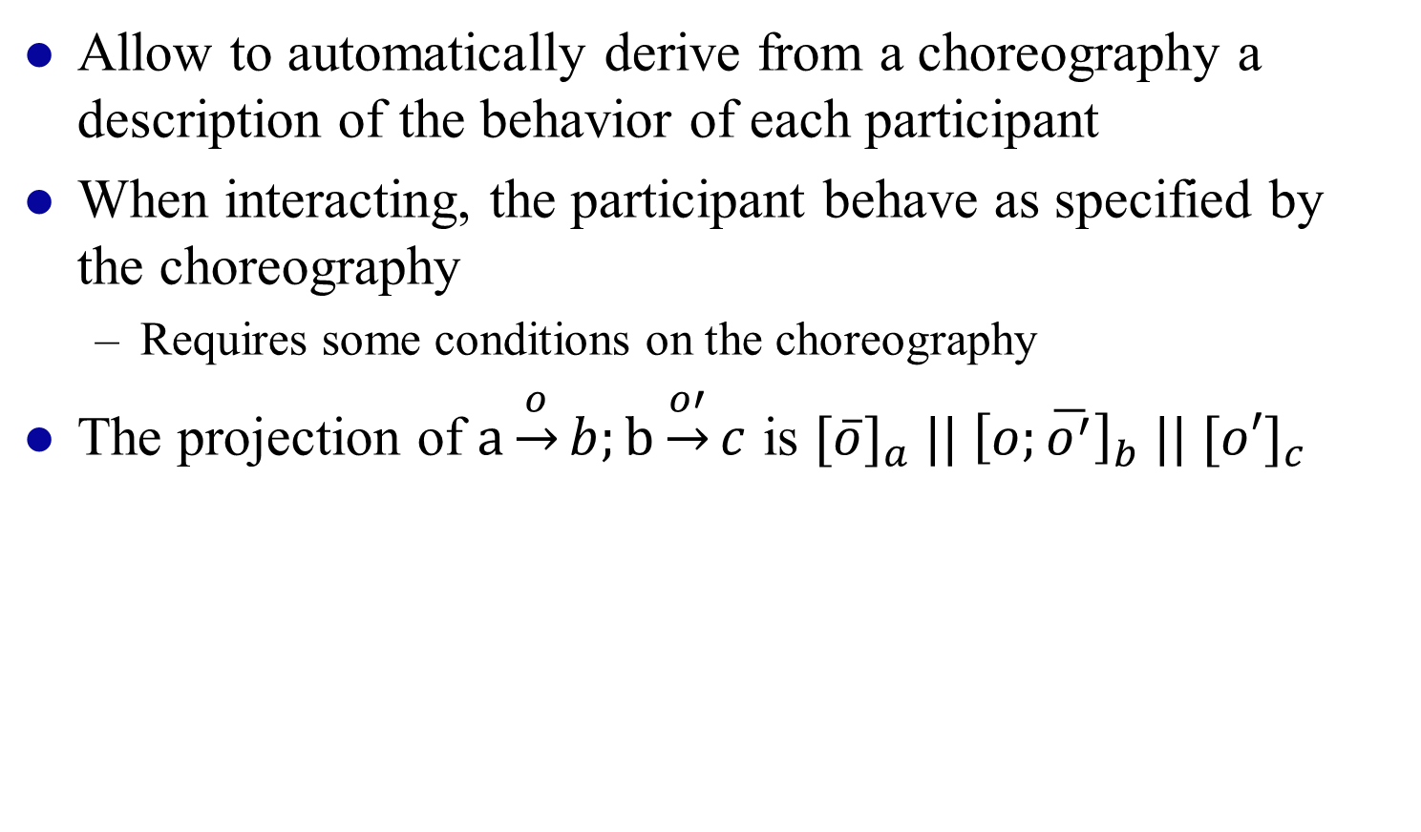
Choreography projection
Allow to automatically derive from a choreography a description of the behavior of each participant
When interacting, the participant behave as specified by the choreography
  Requires some conditions on the choreography
The projection of $a\underset{→}{o}b;b\underset{→}{o′}c$ is ${[\overline{o}]}_{a} ||{ \left[o;\overline{o^{′}}\right]}_{b} ||{ [o′]}_{c}$

Slide 4
Adaptation
Systems should live for long periods of time in ever changing environments
Users can change their minds
The system should adapt to satisfy new requirements
  Adaptation at runtime
  Adaptation details not known when the system has been designed or even started
Lots of works on adaptation
Very little guarentees on what happens after adaptation
  Which properties does the system satisfy?
  Is it still safe?

Slide 5
Our approach
Extend choreographies with adaptation scopes
  Part of the choreography that may be adapted
Adaptation is specified by adaptation rules
  Include the new code for the scope
  Include information on when and where the rule can be applied
The effect of the rules at choreography level is clear
The projection of the rules is applied to the projected system

Slide 6
Our approach, graphically
a
a→
a

Slide 7
Our approach, graphically
a
a→
a
proj

Slide 8
Our approach, graphically
a
a→
a
proj
proj
a→

Slide 9
Results
We can adapt distributed communicating systems
The adaptive system follows the behavior prescribed by the choreography under all possible adaptations
The adapted system is deadlock free by construction

Slide 10
Open issues
Is it possible to restate/extend this approach using multiparty session types?
What is needed to go towards an implementation?
  More concrete language
  Add data
Can we specify other forms of adaptation?

Slide 11
End of talk
Thanks!
Questions?

